Slide 1
HW Security group
regular meeting
2020 Aug 27

Slide 2
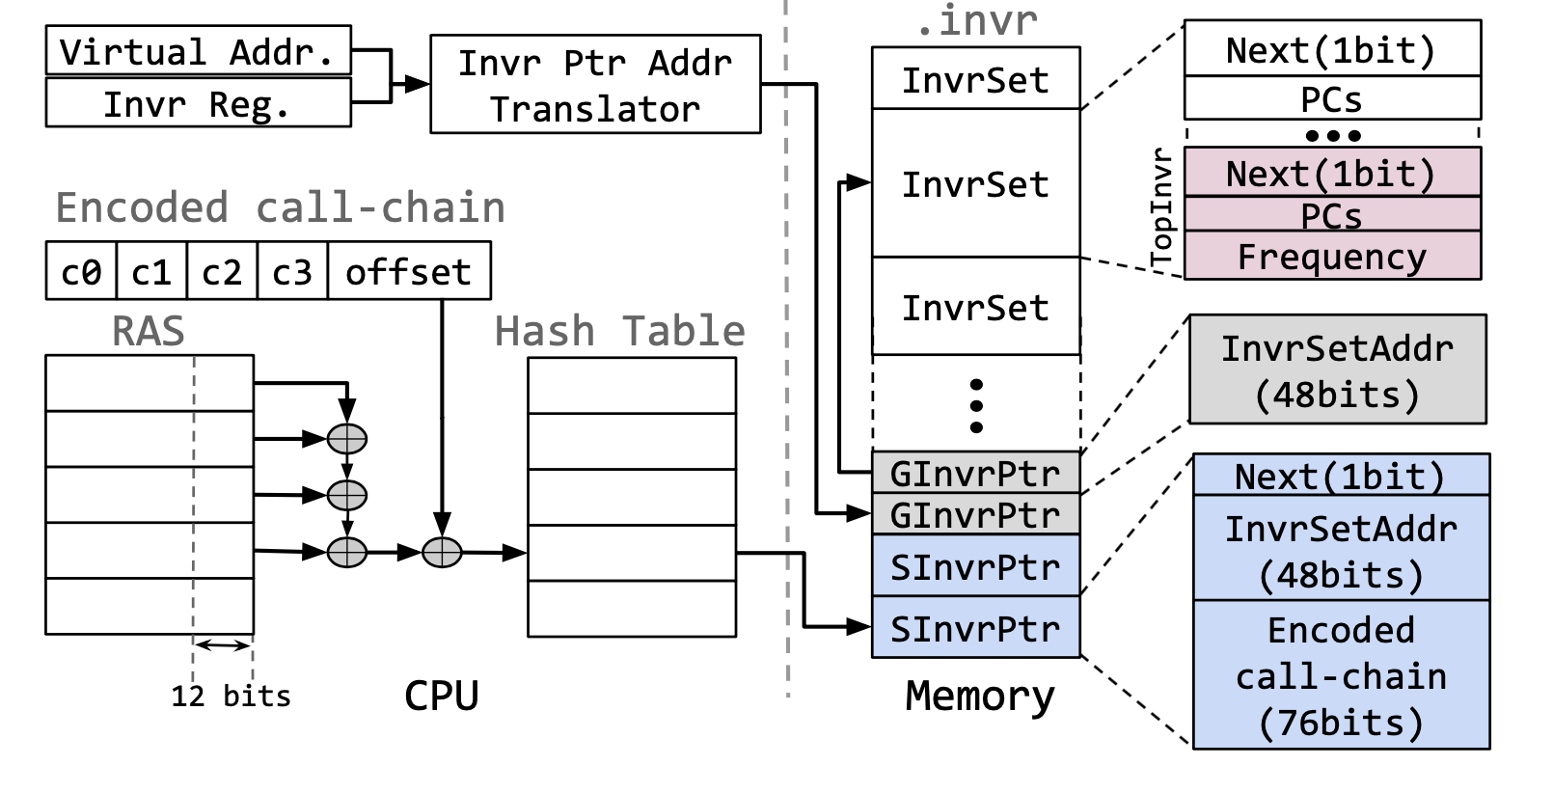
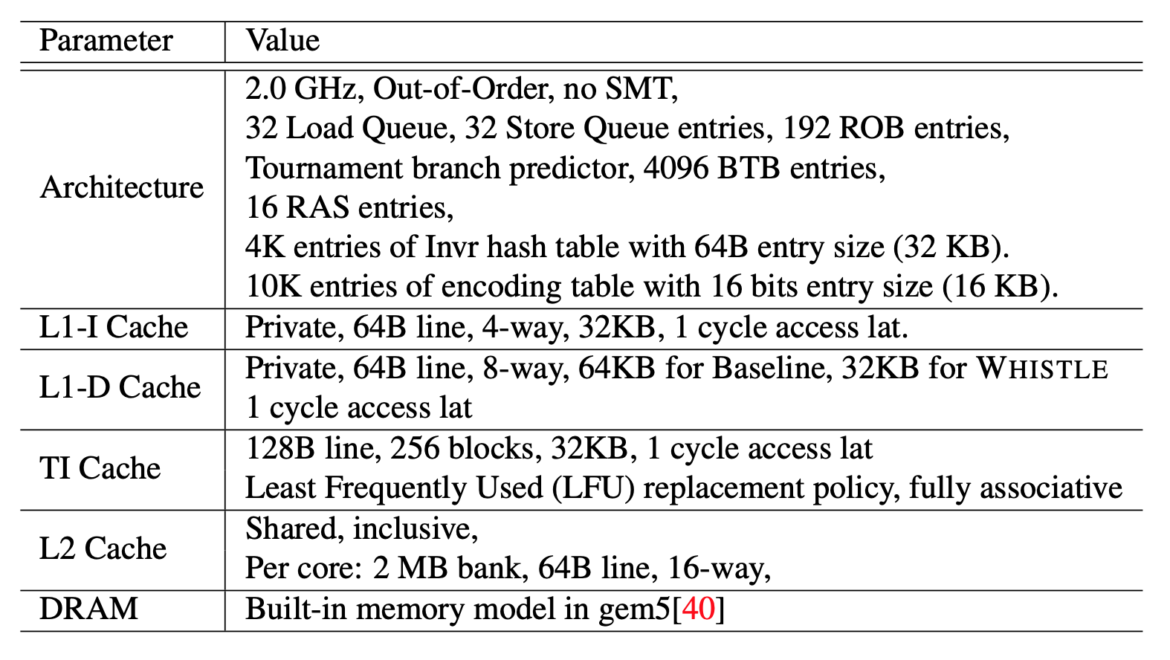
Challenges to encode Call-chain
16KB for encoding table.
Can remove it?
14x4 bits for Call-chain ID
Can reduce it?

Slide 3
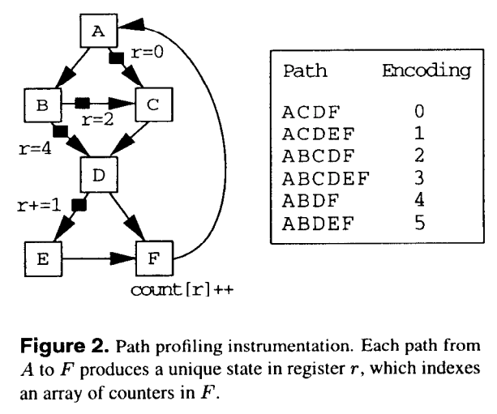
Efficient Path Profile - Ball-Larus(BL) Algorithm
MICRO 29: Proceedings of the 29th annual ACM/IEEE international symposium on Microarchitecture December 1996 Pages 46–57
Label edges in DAG with integer numbers such that each path from entry to exit produce unique sum of edge values along the path.

Slide 4
Efficient Path Profile - Applicable for WHISTLE?
It is designed to encode paths of a basic block
One entry and multiple designated exits.
WHISTLE needs calling-context
One root and every node can be exit node.
(Main → F1 → F2 → F3 → … → Fx) → ID
(A→ B) → 0 (A→ C) → 0
“Precise Calling Context Encoding” addresses same problem with WHISTLE.

Slide 5
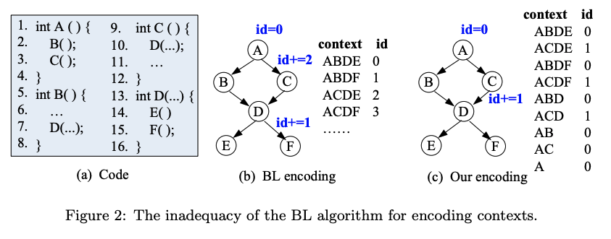
Precise Calling Context Encoding
Sumner, William N., et al. "Precise calling context encoding." IEEE Transactions on Software Engineering 38.5 (2011): 1160-1177.
All paths leading from the root to a specific node have unique encodings, because we only need to distinguish the different context with respect to that node(root).

Slide 6
Precise Calling Context Encoding - Applicable for WHISTLE?
To restore calling context, need extra graph traversal.
Even worse, calling context is not encoded as we wish.

Slide 7
New algorithm inspired by both
Want to distinguish calling text without decoding.
Definition
Calling Graph (CG) is a set of pairs <N,E>
Where N is a set of nodes with each node representing a function
Where E is a set of edges. e ∈ E is a triple (n, m, ℓ), in which n, m ∈ N, represent a caller and callee, respectively, and ℓ represents a call site where n calls m.

Slide 8
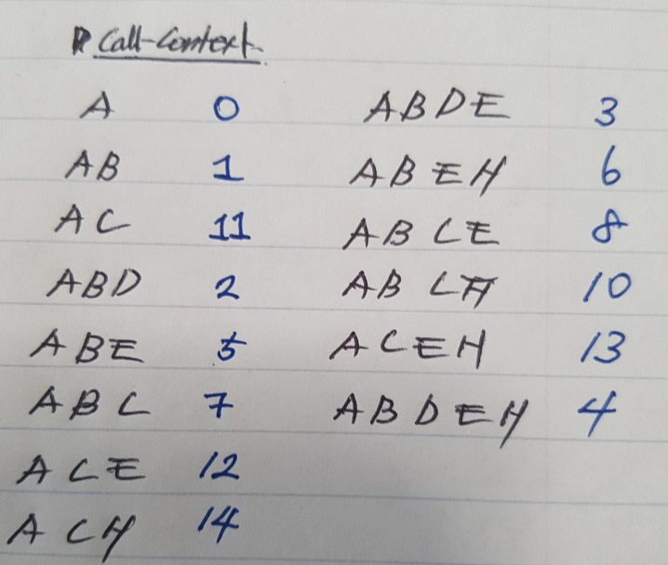
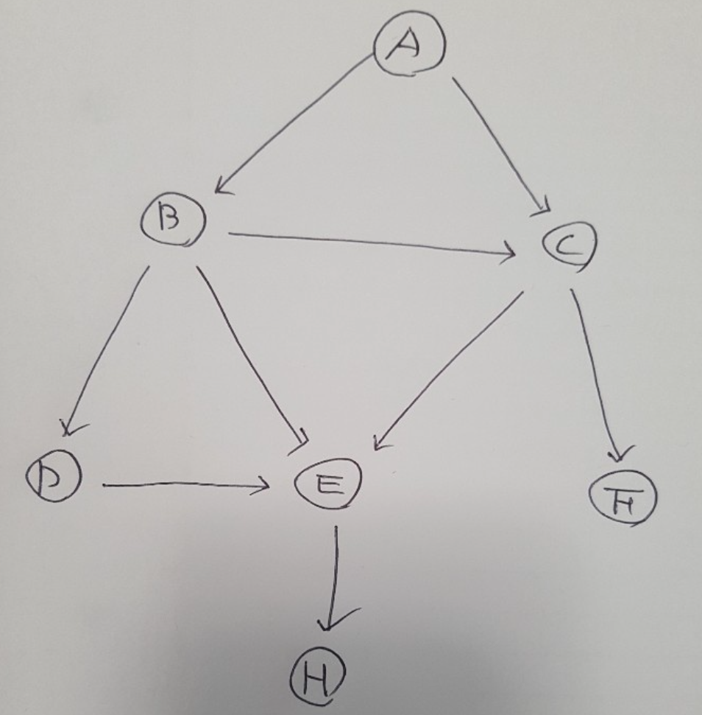
New algorithm inspired by both
DFS (p) {
p.MaxID = 0;
For each e = (p, n, l) in E
Insert ++(p.MaxID) before l;
If n is not visited
p.MaxID = DFS(n) + p.MaxID;
Else
p.MaxID += n.MaxID;
Return p.MaxID;
}

Slide 9
New algorithm inspired by both
How to design for extra computation to sum values on the edges
Insert extra instruction
Extends ISA to store the values.

Slide 10
HW Security group
regular meeting
2020 Sep. 17

Slide 11
Progress
ReViCe
Prepare Presentation September 28 - 30, 2020 - 15m + 5m Q&A (live)
Required to submit the recorded presentation by Sep. 11
Preparation of journal version
TBD, Check TACO journal
WHISTLE
Profile full stack+global memory and analysis (Ongoing)
[Deduplication] implementing unmerge
In-progress, implemented basic functions,
but need to handles exceptional cases such as Coherence protocol
Deduplication rate using Invariant set of full stack-global memory
Calling-Context Encoding algorithm (Ongoing)
Literature survey, Novelty Check, Motivating Applications
Two motivating applications
NoC Security

Slide 12
BL vs PCCE vs DCCE
Design goal and Definitions
Ball and Larus Algorithm (BL)
BL is designed to encode a path starting at ENTRY and ending at EXIT in a DAG.
A Directed Acyclic Graph (DAG) is converted from a Control-flow Graph (CGF).
Precise Calling Context Encoding (PCCE)
PCCE is designed to encode Calling Context.
Calling Context (CC) of a given function invocation m is a path in a Call Graph (CG) leading from the root node to the node m.
IDs of a CC are distinguishable but not between IDs of different CCs.
Distinguishable Calling Context Encoding (DCCE)
DCCE can encode CC with unique ID across all the contexts.

Slide 13
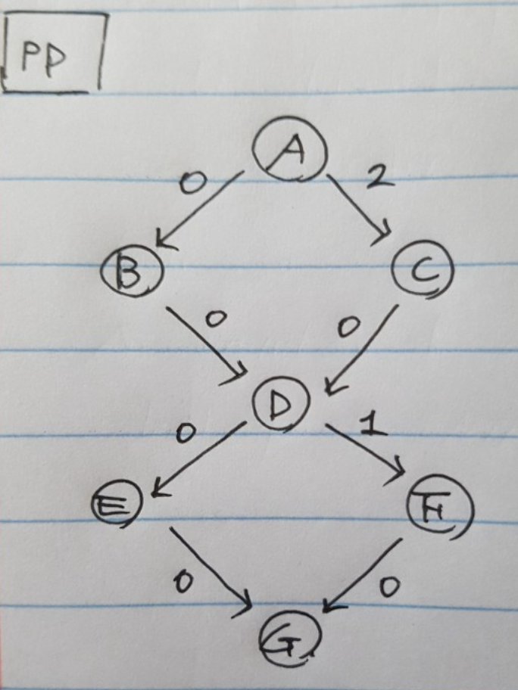
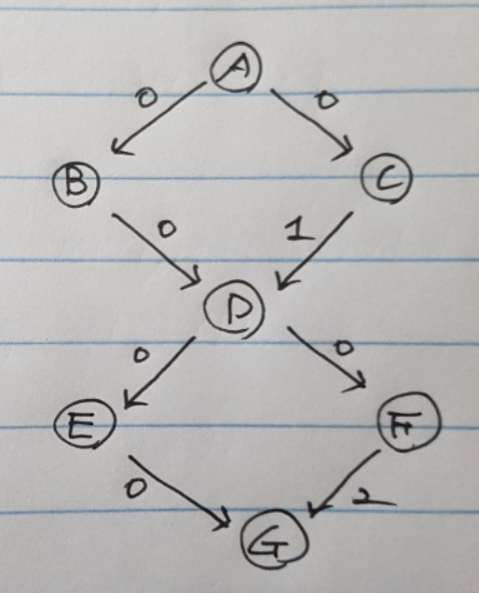
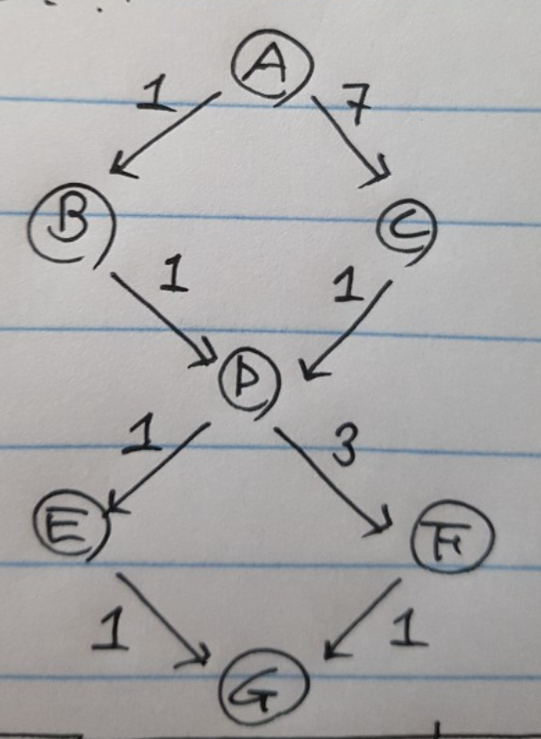
BL vs PCCE vs DCCE - Example
 | ID(BL) | ID(PCCE) | ID(DCCE)
A | N/A | 0 | 0
AB |  | 0 | 1
AC |  | 0 | 7
ABD |  | 0 | 2
ACD |  | 1 | 8
ABDE |  | 0 | 3
ACDE |  | 1 | 9
ABDF |  | 0 | 5
ACDF |  | 1 | 11
ABDEG | 0 | 0 | 4
ACDEG | 2 | 1 | 10
ABDFG | 1 | 2 | 6
ACDFG | 3 | 3 | 12
BL PCCE DCCE

Slide 14
Motivation of DCCE
PCCE + Function ID → DCCE ?
It’s reasonable with SW-based application.
Easy to associate PCCE and Function ID.
However, for HW-base application (like WHISTLE)
It is hard to keep track of a function ID.
No notion of a function, just jump to another PC. → Inherently imprecise
Is the algorithm novel?
So far, yes it is.

Slide 15
Stronger Motivation of DCCE (Appealing Use cases)
Call-flow integrity?
Each function stores IDs of CCs that can legally call a current function.
For a function call, check if ID of CC that calls the current function is in the list.
Similar approach for ROP.
Cannot use PCCE for this application.
Extended WHISTLE? Or Performance counter for SW-based?
Provide IDs of CCs as a HW performance counter for some analysis
Context Sensitive Points-to analysis (ex. Dynamic Pointer Disambiguation)
DFS acts like following an order of program’s function calls.
Current algorithm needs instrumentation with a complete CG.
Can DCCE be done at runtime without instrumentation and CG?
No, Different run may take different paths in CG.
Each run generate IDs but cannot use for other runs.
If it’s possible, above application will be much more appealing.
Can reduce a phase to construct a CG
No overhead of instrumentation (or generalized as a part of calling convention)

Slide 16
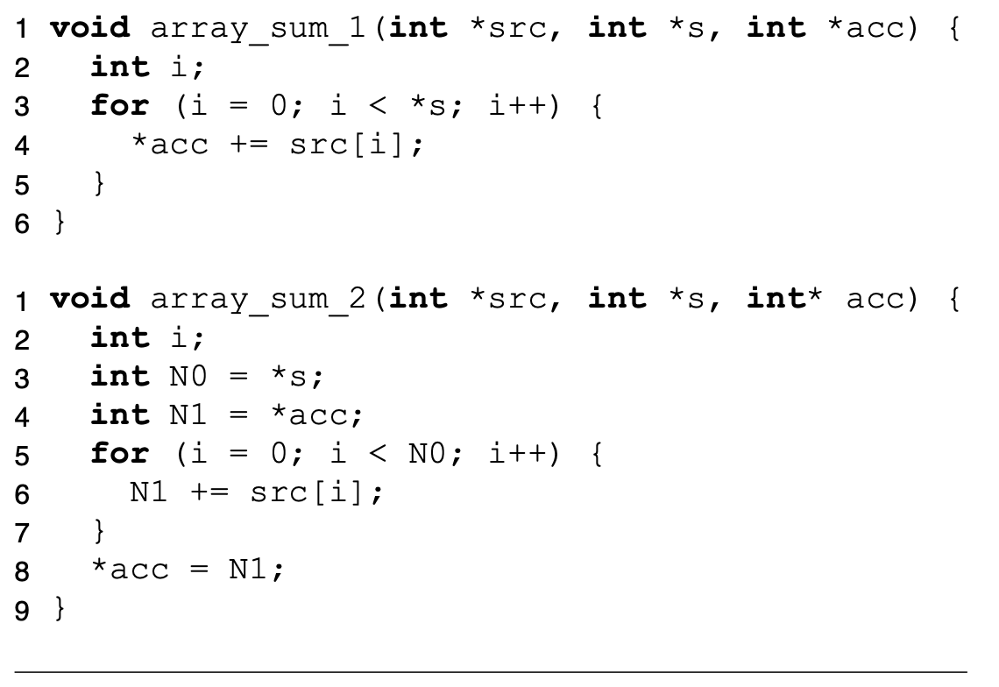
Runtime Pointer Disambiguation
Compilers cannot optimize array_sum_1 to array_sum_2
Pointer Aliasing hinders optimizations.
Loop invariant code motions
Code parallelization/vectorization.
This paper propose to solve it through dynamic pointer disambiguation.

Slide 17
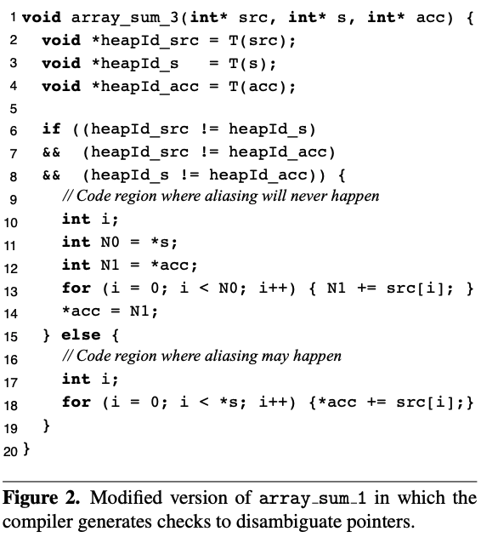
Runtime Pointer Disambiguation
Modify memory allocator
Bind meta-info to pointers (func. T)
Base, size, unique id
Insert check and maintain different versions.
O(N²) where N is number of pointers in a region. (Expensive)
T is logarithmic on the number of currently alive memory allocations

Slide 18
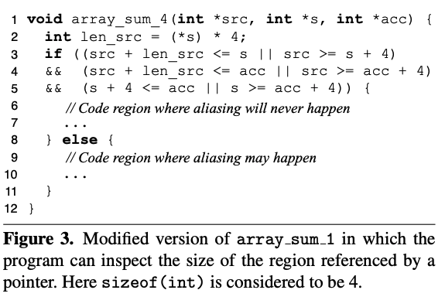
Runtime Pointer Disambiguation
To reduce the overhead of runtime checks
Prune some of checks with profiler.
If a pair of pointers is found to alias with some probability, do not check disambiguate dynamically

Slide 19
Runtime Pointer Disambiguation with DCCE
Construct a CG and instrument source code to encode CCs.
Run the instrumented program and analyze pointer alias and remember IDs that does not have aliases. (IDx)
Instrument source code to take an optimized code if runtime ID (IDy) equals to IDx.
get_ccid() takes constant time.
No need for changes of memory allocator.
void array_sum_5(int* src, int* s, int* acc) {
int id = get_ccid();
if (id == 3 || id == 4) { // instrumented
// optimized code
} else {
// not optimized code
}
}

Slide 20
Next Plan
ReViCe
Prepare Presentation September 28 - 30, 2020 - 15m + 5m Q&A (live)
Required to submit the recorded presentation by Sep. 11
Preparation of journal version
TBD, Check TACO journal
WHISTLE
Profile full stack+global memory and analysis (Ongoing)
[Deduplication] implementing unmerge
In-progress, implemented basic functions,
but need to handles exceptional cases such as Coherence protocol
Deduplication rate using Invariant set of full stack-global memory
Calling-Context Encoding algorithm (Ongoing)
Literature survey, Novelty Check, Application(motivation)
Consider practical issues (Encoding space, Function pointers, recursion, etc.)
Evaluation methodologies - benchmarks, tools, types of statistics
NoC Security

Slide 21
HW Security group
regular meeting
2020 Dec. 17

Slide 22
Agenda (Calling Context Encoding)
Updated algorithm for a cycle with multiple entries.
Contributions and Challenges.
Evaluation methodology.

Slide 23
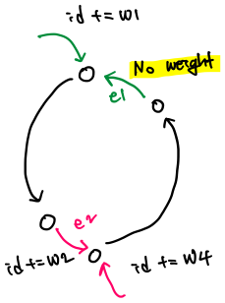
Updated algorithm for a cycle with multiple entries

Slide 24
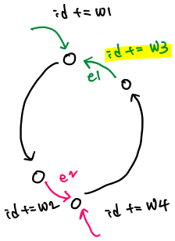
Updated algorithm for a cycle with multiple entrise
Instrument backedge.

Slide 25
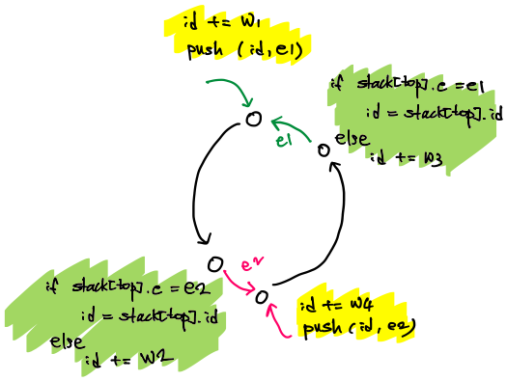
Updated algorithm for a cycle with multiple entries
At callsite that enters a cycle:
Push (id, backedge) to stack.
At callsite that forms a cycle.
Replace id with id at the top of stack

Slide 26
Calling Graph (CG) is a set of pairs <N,E>
Where N is a set of nodes with each node representing a function
Where E is a set of edges. e ∈ E is a triple (n, m, ℓ), in which n, m ∈ N, represent a caller and callee, respectively, and ℓ represents a call site where n calls m.
S is a set of pairs of two callsites (ee, be) where “ee” is a callsite that is an entry edge of a cycle and “be” is a callsite that is backedge of the cycle.
Instrument1 (n) {
n.MaxID = 0;
For each e = (n, m, l) in E
Insert ++(n.MaxID) before l;
If m is not visited
n.MaxID = Instrument1(m) + n.MaxID;
Else if e creates cycle
--(n.MaxID);
Else
n.MaxID += m.MaxID;
Return n.MaxID;
}
Instrument2 (S) {
For each (ee, be) in S
Insert “push (id, be)” before ee
Replace “id += w” with
“
If stack[top].e == be
Id = stack[top].id
Else
Id += w
“
}

Slide 27
Contributions and Challenges
Differentiate CCID across functions.
HW supported encoding?
Need some hybrid approach to resolve limitations?
Related works
PCCE (`10 ICSE)
Reuses BL algorithm for CC encoding.
Handle Recursive Call
Using stack offset to reduce instrumentation.
Delta Path (`14 CGO)
Support large and more complex call graphs (integer overflow).
Handles dynamic libraries and dynamic dispatch (handling dynamic characteristics).
DACCE (`14 CGO)
Handles dynamic libraries and indirect calls (handling dynamic characteristics).
Update encoding at runtime.
Valence (`19 CC)
Support more scalable encodings using variable length CC encoding (integer overflow).

Slide 28
Evaluation methodology
Experiments
Target benchmarks: SPEC, Parsec, others apps (cmp, diff, sdiff, find, locate, grep, tar, make alpine, vim)
Static context characteristics
LOC, CG nodes, CG edges, recursions, func pointers, MaxID + paper specific stats.
Dynamic if necessary
Performance overhead
Tools
SW based: Compiler (Valence-LLVM), Source to source instrumentation (PCCE - CLI).
HW based: static analysis + simulation with proposed HW using gem5.

Slide 29
HW Security group
regular meeting
2021 Jan. 7

Slide 30
Agenda (Calling Context Encoding)
Wrote Abstract (including motivation, basic idea, and evaluation)
Evaluation Method

Slide 31
Abstract
Many encoding schemes of a calling context are being studied to get a program's behavior. These schemes are used for many applications such as program analysis, debugging tools and security purpose. Some of these applications are offline work or some others are online. However, existing encoding schemes limit the application in that the context is encoded at runtime but the encoded context (ID) cannot be directly used at runtime to distinguish the contexts ending with different functions. In addition, their decoding algorithms are not efficient to use at runtime because it incurs many extra instrumentations (or instructions). Its inefficiency is amplified as the runtime system uses the ID more frequently (or for every function call). In this paper, therefore, we propose a new category (?) of the calling context encoding scheme to generate a self-distinguishable context ID (without decoding). Our proposal is based on precise calling context encoding (PCCE) - assigns weights to some edges in a call graph and add/remove the weights when entering/leaving functions. However, our algorithm assigns the value differently to avoid duplicated IDs over the entire program execution. Our experiments show that the performance overhead is X% which is the minimum compared to the existing encoding schemes (PCCE, Valence) with Y%, Z% respectively.

Slide 32
Abstract
Need to find enough previous work that need the self-distinguishable context ID? (Accmon, WHISTLE, …)
Or we argue that the proposal is good for a new work like WHISTLE
Motivation
Many encoding schemes of a calling context are being studied to get a program's behavior. These schemes are used for many applications such as program analysis, debugging tools and security purpose. Some of these applications are offline work or some others are online. However, existing encoding schemes limit the application in that the context is encoded at runtime but encoded ID cannot be directly used at runtime to distinguish the contexts ending with different functions. In addition, their decoding algorithms are not efficient to use at runtime because it incurs many extra instrumentations (or instructions). Its inefficiency is amplified as the runtime system uses the encoded ID more frequently (or for every function call). In this paper, therefore, we propose a new category (?) of the calling context encoding scheme to generate a self-distinguishable context ID (without decoding). Our proposal is based on precise calling context encoding (PCCE) - assigns weights to some edges in a call graph and add/remove the weights when entering/leaving functions. However, our algorithm assigns the value differently to avoid duplicated IDs over the entire program execution. Our experiments show that the performance overhead is X% which is the minimum compared to the existing encoding schemes (PCCE, Valence) with Y%, Z% respectively.
Idea
Evaluation

Slide 33
Evaluation methodology
DeltaPath (`14 CGO)
Jikes RVM
Compared with PCCE and PCC.
SPECjvm2008
Valence (`19 CC)
LLVM
Compared with PCCE
SPEC2017
Our scheme
LLVM
Compare with PCCE and Valence
SPEC2017

Slide 34
Plan
Finding good use cases of our algorithm.
Keep studying prior works to
Make our idea strong
Find some hints to solve integer overflow problems.
Evaluation
Integrate our algorithm to LLVM.
Implement PCCE, Valence and integrate to LLVM.

Slide 35
HW Security group
regular meeting
2021 Jan. 14

Slide 36
Progress
Implementation
Writing a llvm pass to insert IRs to update IDs.
Need to check if it is efficient enough (related with execution time).
Build configuration of SPEC2017 for clang compilation with the generated pass.
Double checking the pass works with benchmarks. (ignoring intrinsic calls or indirect calls)
Interface between Encoder and the Pass.
Need to change format of .cc file.
Next week.

Slide 37
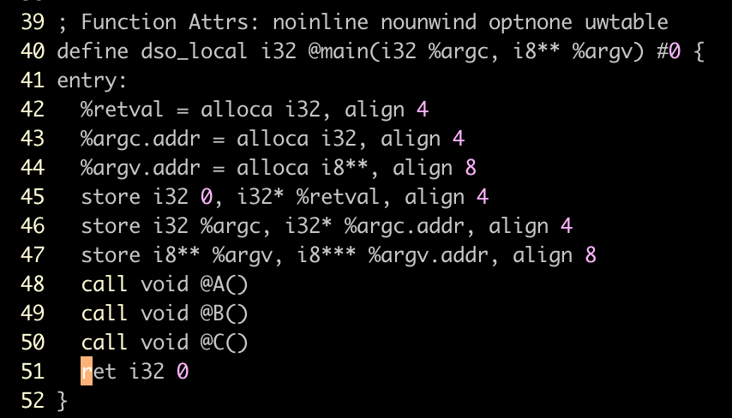
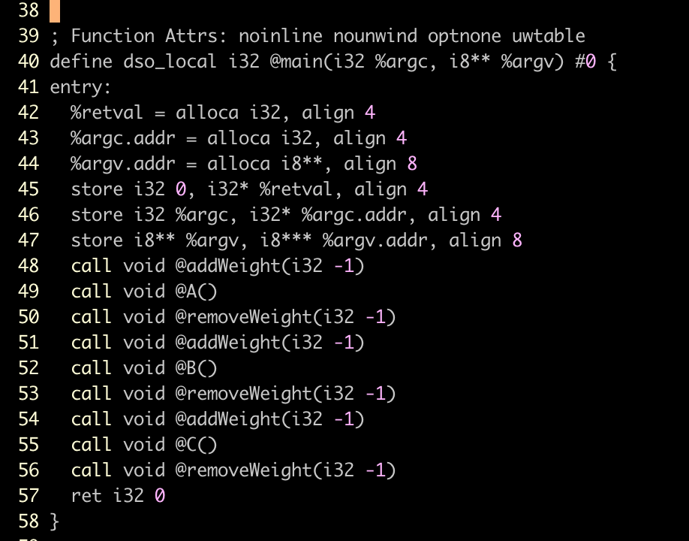
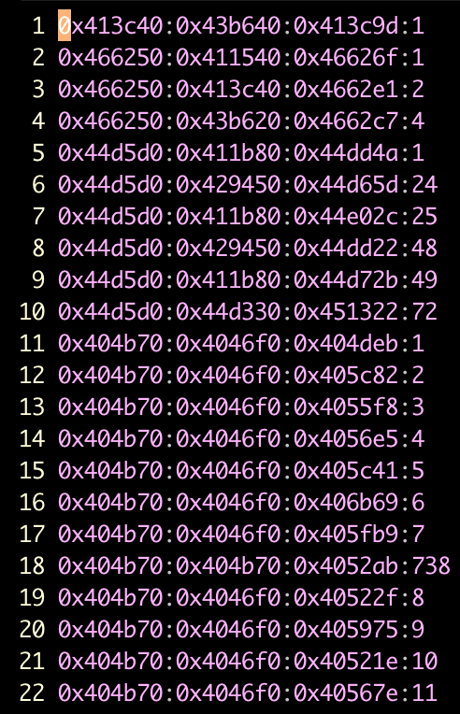
Overall Design
Machine code
Front End
(clang)
Pass
DCCE
Pass
Pass
Front End
IR
IR
IR
IR
Benchmark
Call Graph Generator
(SVF)
Calling Context Encoder
.dot
.cc

Slide 38
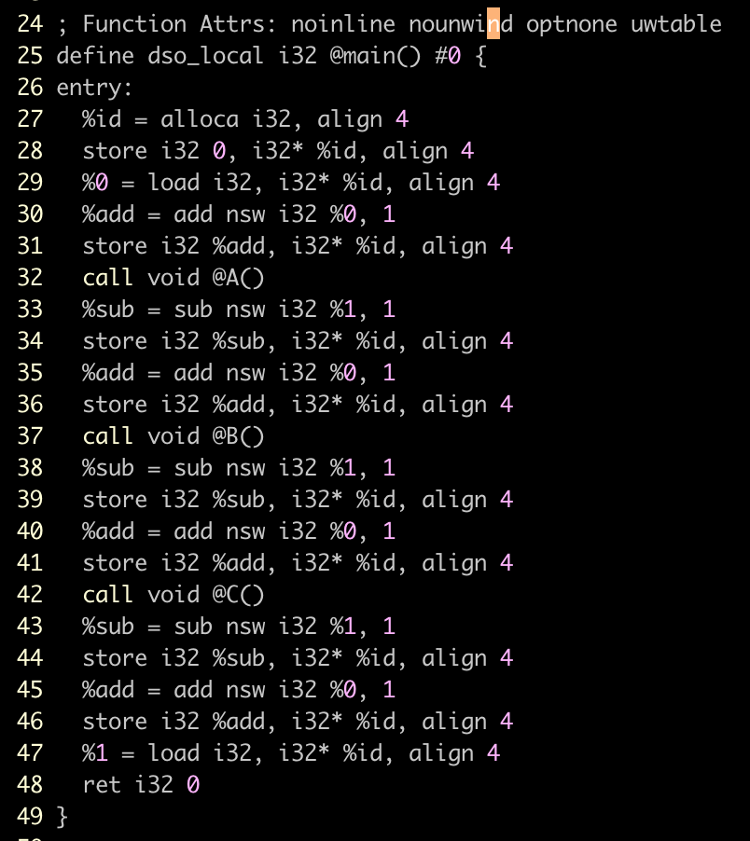

Slide 39
HW Security group
regular meeting
2021 Jan. 21

Slide 40
Agenda
Progress
Implementation
Modify SVF to dump call graph with IDs and symbols of caller/callee/callsite.
IDs of them in .dot are generated by llvm-lib cannot be used directly in LLVM pass.
Huge MaxID (Is it a bug or it it possible number?)

Slide 41
Overall Design
SPEC 2017 Build System
DCCE
?
Front End
(clang)
PASS
PASS
CG
GEN
(SVF-WPA)
Instrumentation
Back End
Benchmark
IR
IR
IR
IR
IR
Machine code
Calling Context Encoder
CSID?
CRSYM:CSID:CESYM
.cg
.cc
CRSYM:CSID:CESYM:WEIGHT

Slide 42
Statistics of call graph and Its MaxID
See the excel sheet.

Slide 43
Next Plan
Implementation
Integrate SVF (WPA) to DCCE pass so as to match callsite during instrumentation.
Integrate backend
Find out the reason of huge MaxID (600.perlbench)

Slide 44
HW Security group
regular meeting
2021 Jan. 28

Slide 45
Agenda
Progress
Experiment setup is almost done.
LLVM pass for instrumentation is integrated to SVF.
Compile / Callgraph issue with some benchmarks.
Execution time - Baseline / DCCE
Huge MaxID (Is it a bug or it it possible number?)
Following footprint manually (so far no problem)

Slide 46
Overall Design
Benchmark Building System
DCCE
Real Machine Experiment
PASS
SVF-WPA
rtlib
Dump callgraph
Back End
(clang)
Host PC
Front End
(clang)
IR
Instrument
IR
Benchmark
IR
Machine code
Calling Context Encoder
Simulation
.cg
.cc
IR
Gem5
(Extended ISA)
(Extended Arch)
Extended Backend
Machine code
CRSYM:CSID:CESYM:??
CRSYM:CSID:CESYM:WEIGHT

Slide 47
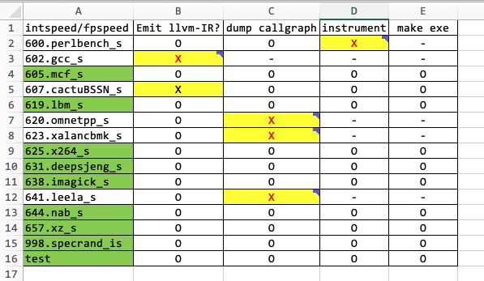
Target Benchmarks
SPEC2017 - intspeed and fpspeed
Both are time-based metric
Different data type to operate (integer/floating point)
Only C/C++
13 benchmarks + 2 microbench(for testing). 9 benchmarks are available now.
Issue
Compile failure with Emit-llvm option (602, 607)
Assertion failure while dumping call-graph (callsite without ID, 620, 623, 641).
Instrumentation failure due to integer overflow (600)

Slide 48
Initial Results (Execution Time)
base-nopg
No modification is made. Just built with clang.
base2-nopg
Empty function is inserted to remove effect of function call.
Inserting function call to runtime lib (static) is easier than inserting a log of IRs.
Dcce-rtlib-nopg
Using rtlib
Dcce-ldst-nopg
Insert IR of ld/add/store instructions.
In order to compare with dcce-rtlib

Slide 49
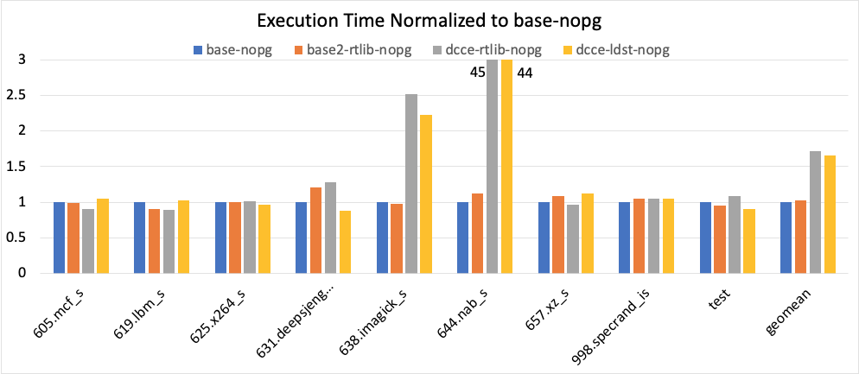
Initial Results (Execution Time)

Slide 50
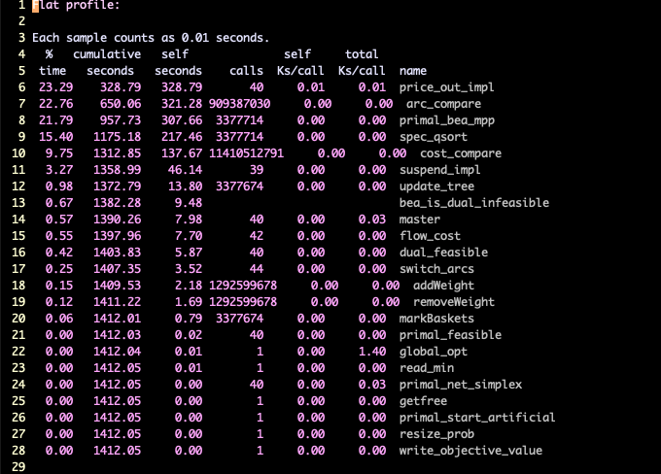
Initial Results (Execution Time) - gprof

Slide 51
Next Plan
Experiment setup
Fix issues (compile, callgraph, instrument)
Analysis 644.nab_s
Integrate PCCE and get results
Huge MaxID (Is it a bug or it it possible number?)
Continue debugging

Slide 52
HW Security group
regular meeting
2021 Feb. 4

Slide 53
Agenda
Experiment setup.
Compile / Call Graph issue with some benchmarks.
Call graph / Instrumentation issue Fixed
620.omnetpp_s, 623.xalancbmk_s, 641.leela_s - multiple locations to return (try/catch)
Instrumentation failure due to integer overflow (600) → use “0” weight
Fixing compile issue - 602.gcc_s, 670.catcuBSSN_s
Bug fixes
Implement PCCE
Acyclic graph encoding
Decoding - two functions InitCallgraph(), Decode()
Simulation result - execution time (Baseline / DCCE / PCCE)
Analysis on 644.nab_s (huge overhead due to encoding in the hot routine.)
Discussion about the fair comparison
Huge MaxID (Is it a bug or it it possible number?)
Verification with well-known algorithm
number of paths from source to destination in acyclic directed graph
Analysis using #neighbors/#incidents

Slide 54
Analysis 644.nab_s
See Issue#1

Slide 55
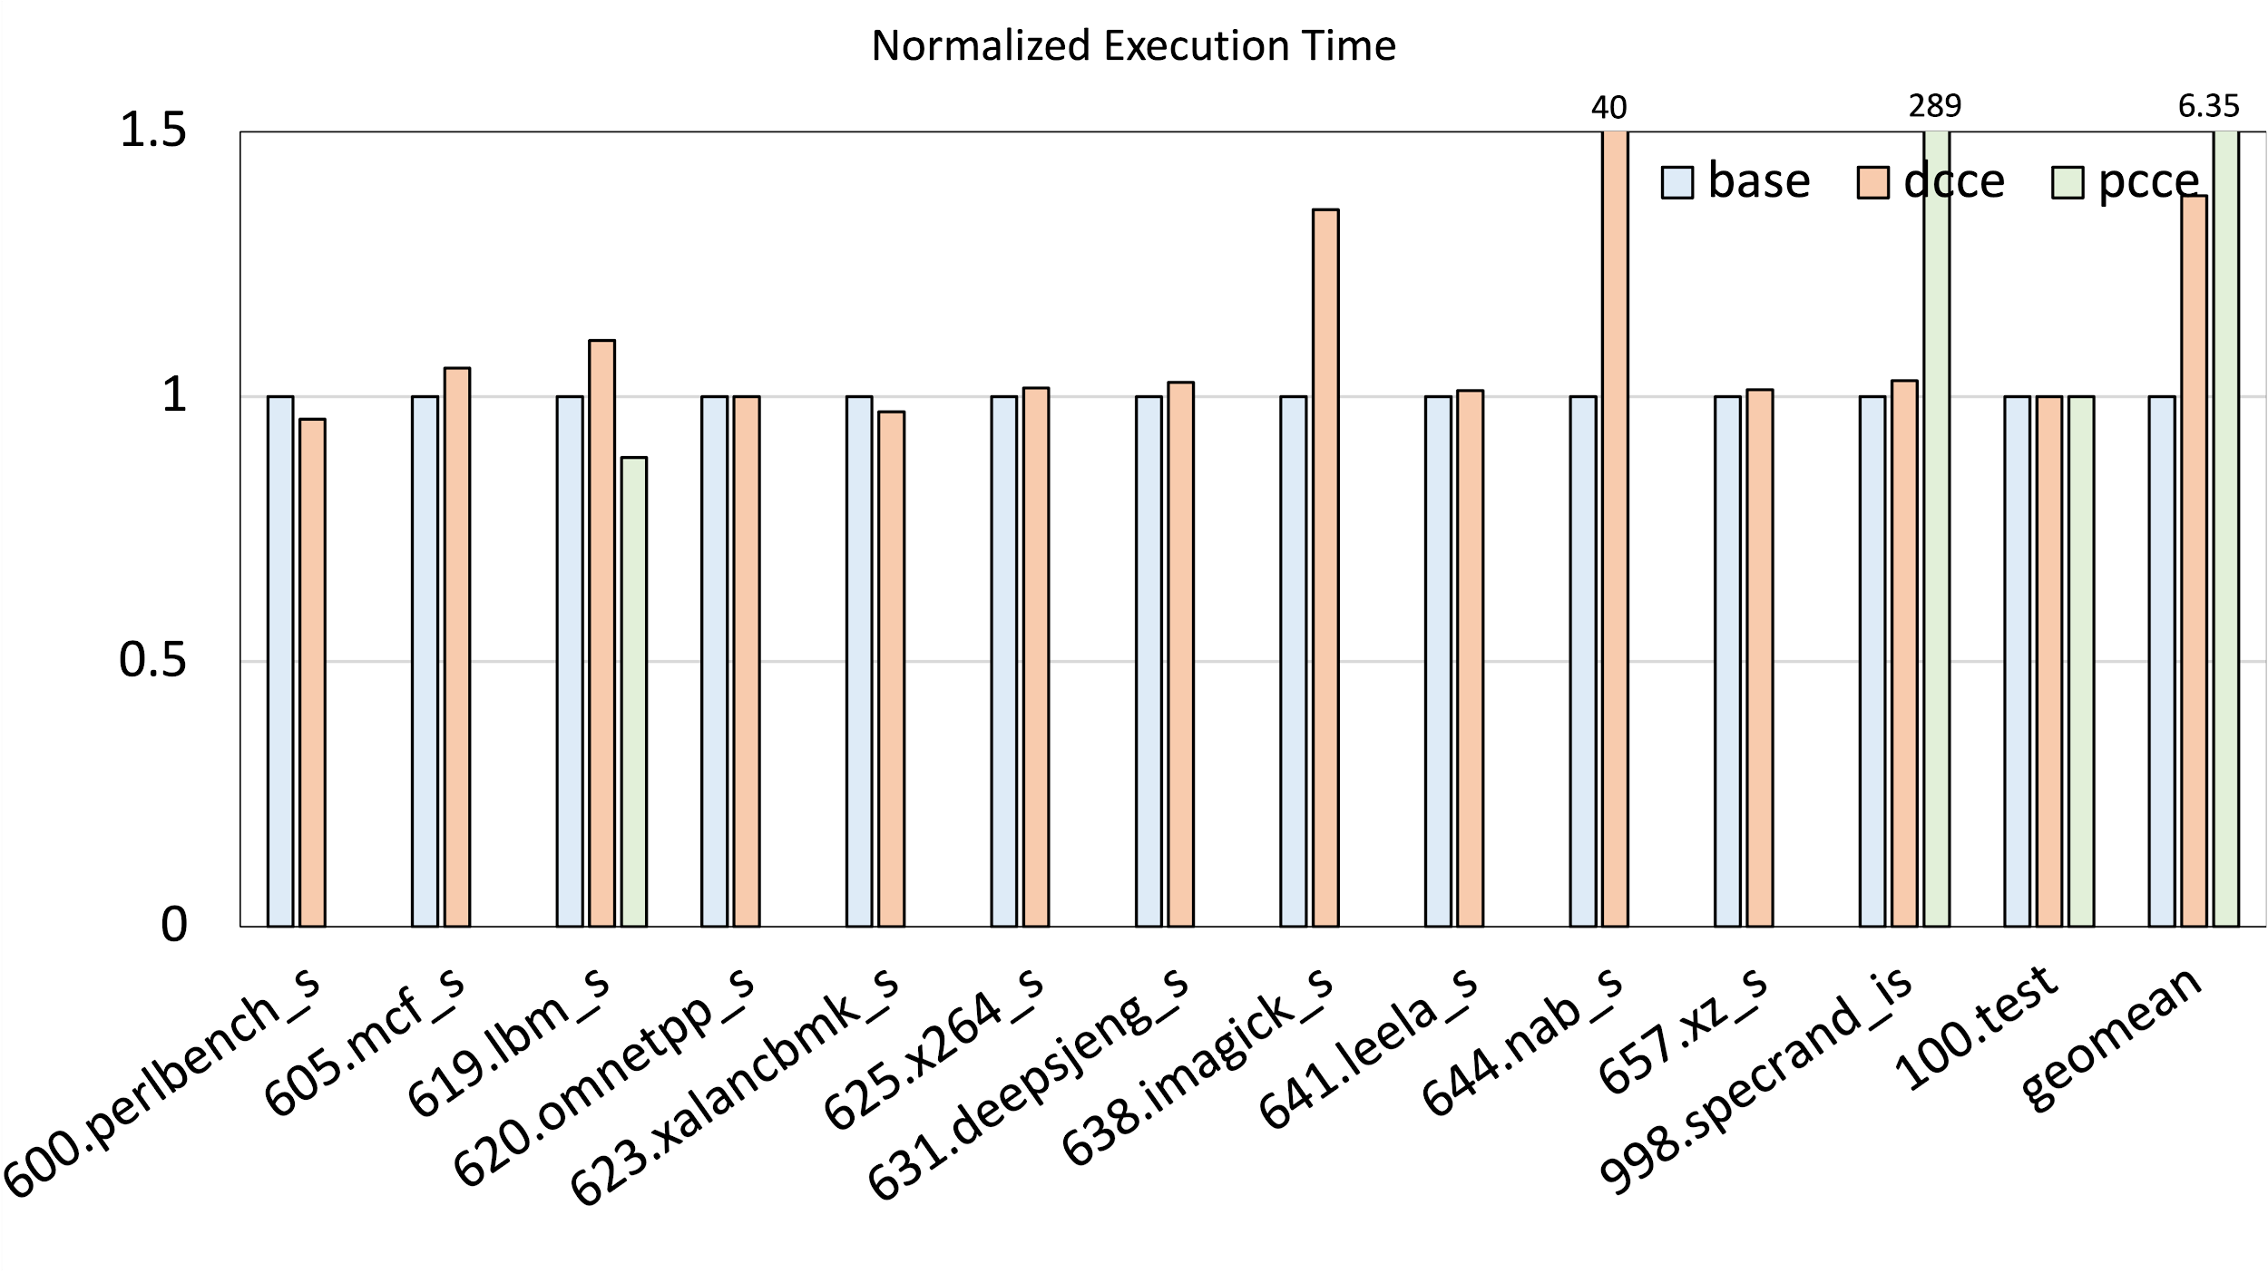
Simulation Result

Slide 56
Fair comparison
When to decode?
Every function call
How to decode?
Decode full path (tracing back from current to root node, O(logn))
Concatenating function signature
Encode recursive call?

Slide 57
MaxID - verification
Let DP(u) be the number of paths from u to destination.
DP(dest) = 1 DP(others) = 0
DP[i] = DP[i] + DP[j]
where i is the list of node id that are reverse order of topo sort
j is the list of neighbor node id
DP[4] = 1
DP[3] = DP[3] + DP[4] = 1
DP[2] = DP[2] + DP[3] = 1
DP[1] = 0 (no neighbors)
DP[0] = DP[0] + DP[1] = 0
DP[0] = DP[0] + DP[2] = 1
DP[0] = DP[0] + DP[3] = 2
DP[0] = DP[0] + DP[4] = 4
src
dest

Slide 58
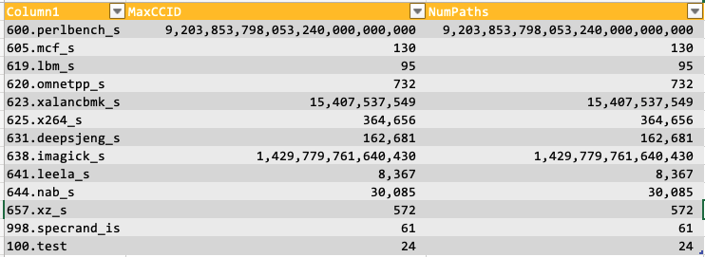
MaxID - verification

Slide 59
MaxID - verification
See Excel file

Slide 60
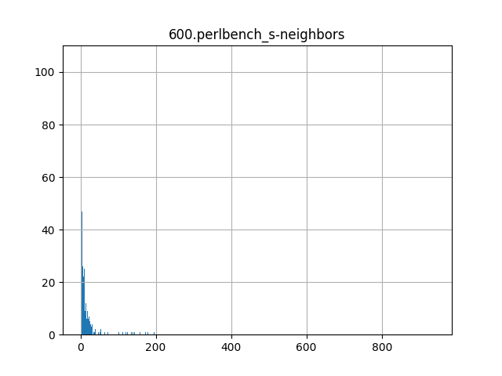
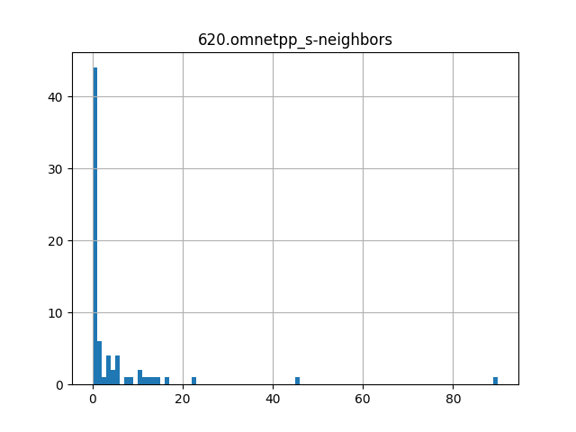
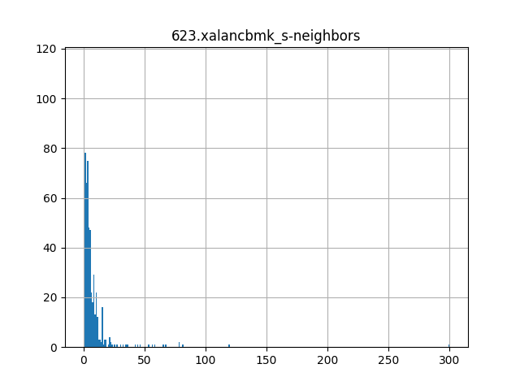
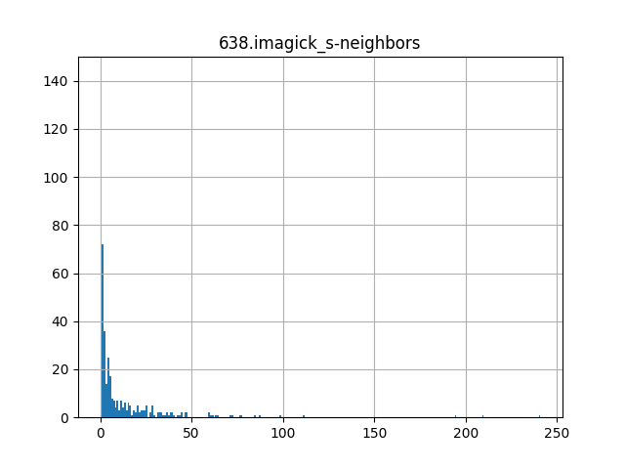
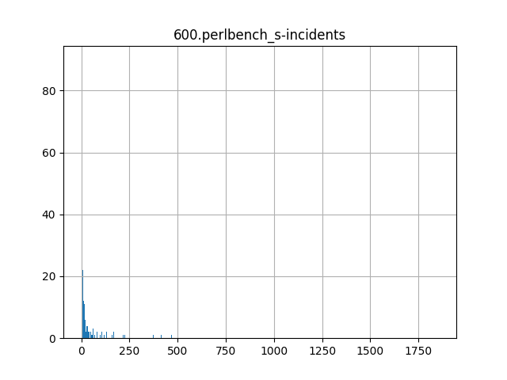
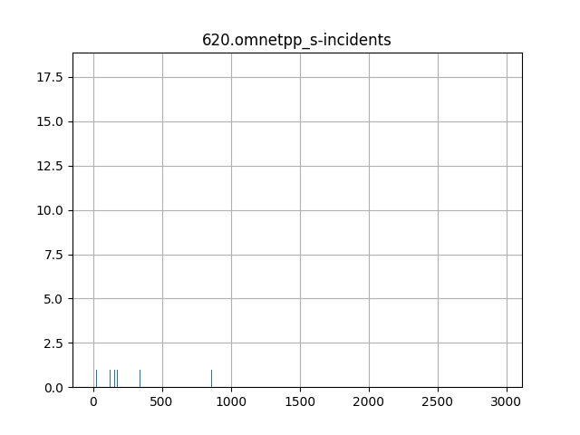
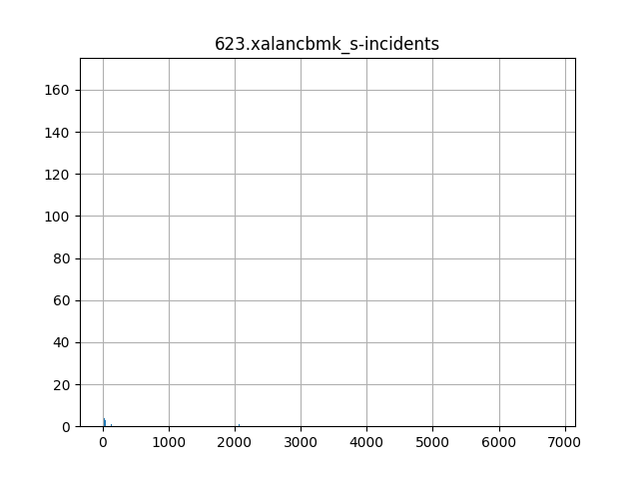
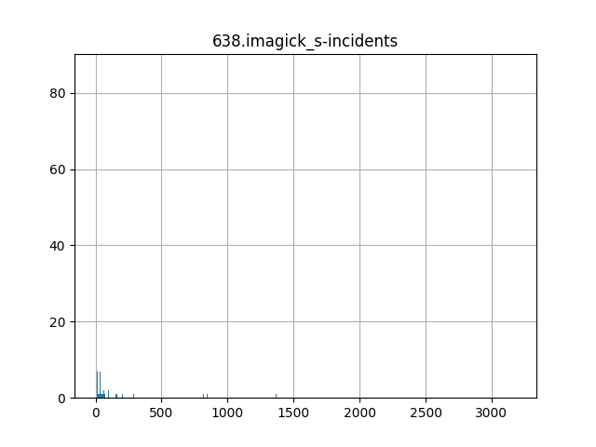

Slide 61
HW Security group
regular meeting
2021 Feb. 11

Slide 62
Progress and Agenda
Plan for WHISTLE
DCCE
Use case survey (Need for strong motivation)
Encoding cyclic call graph.
Experiment
Fix compile issues
Run PCCE with all benches with lightweight decoding scheme

Slide 63
Use case of DCCE
Anomaly detection using stack frame information (Feng, SP’03)
Unearthing Stealthy Program Attacks Buried in Extremely Long Execution Paths (Shu, CCS’15)

Slide 64
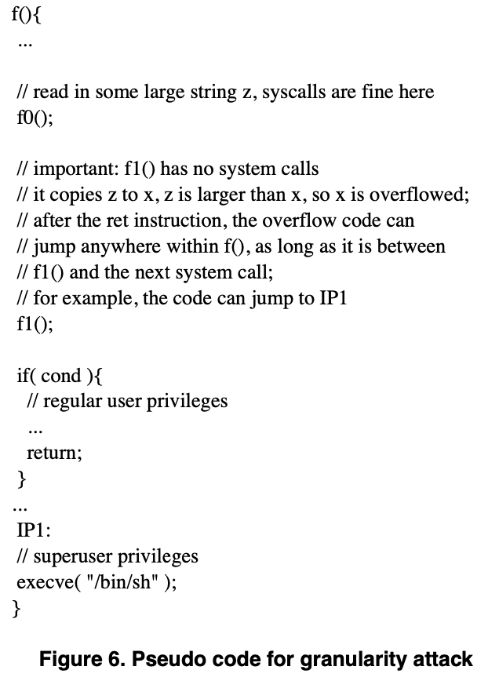
Anomaly Detection using stack frame

Slide 65
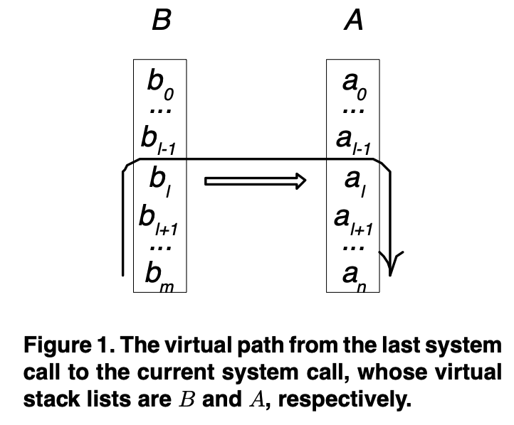
Anomaly Detection using stack frame
Idea: extract return address from the call stack and generate abstract execution path between two program execution points.
Profile based (invariant) work.
Virtual Stack list A = {a0, a1, …, an-1}
Virtual Path
For checkpoints
Stack anomaly.
Return address anomaly.
System call anomaly.
Virtual path anomaly.

Slide 66
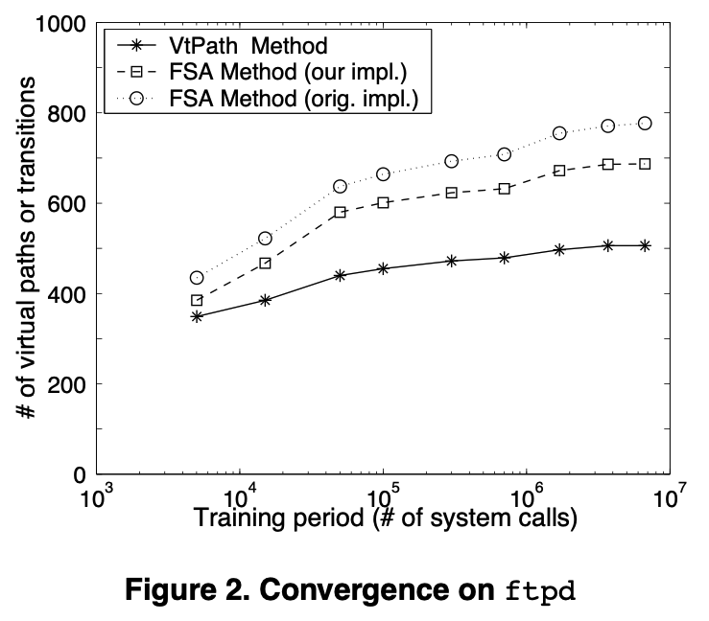
Anomaly Detection using stack frame
Convergence
Run benchmarks until X number of system call is invoked.
X ranges from small to many.

Slide 67
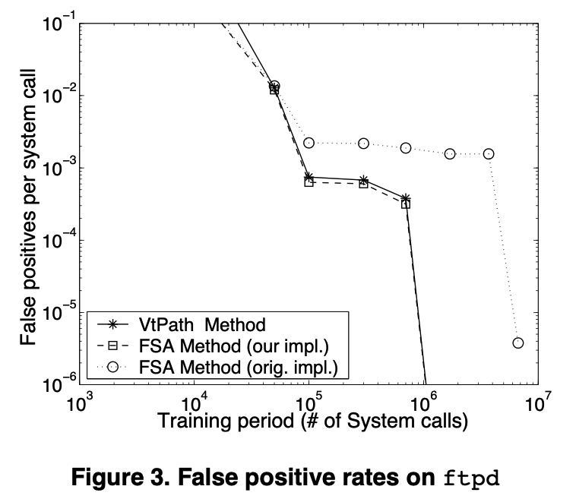
Anomaly Detection using stack frame
False Positive
Execution is slightly different from what was used for the convergence.
#false positive / #system call

Slide 68
Can DCCE be used to detect anomaly?
Can calling context be used to detect this type of attack?
Foo() {
// ID == 10
if (…) {
ID += w // ID == 11
Call victim // buffer overflow changes return address
ID -= w // this is the return site.
return;
}
…
// return to here after attack
if ( ID not in the list for syscall A) exception!!
// invariant = { 10}
syscall A
}
// Possible to make a valid ID for syscall A?

Slide 69
Can DCCE be used to detect anomaly?
Can calling context be used to detect this type of attack?
Foo() {
if (…) {
Call victim, w // buffer overflow changes return address
return; // this is the return site.
}
…
// return to here after attack
syscall A // syscall includes check if ID is not in the list
}
What if victim function has syscall A?
Need for collecting control flow?

Slide 70
Anomaly Detection using stack frame
Idea: extract return address from the call stack and generate abstract execution path between two program execution points.

Slide 71
Encoding Cyclic Call Graph
PCCE
Acyclic encoding is pushed to the stack when a recursion occurs.
The number on the stack and the current ID together represent the context.
Decode sub-path wise.
Valence
Encode cyclic edges separately with compact bits. (ceil(log(#cyclic edges))
Edges that begins and ends in the same SCC are cycles edges.
Cyclic edges must be part of a cycle.

Slide 72
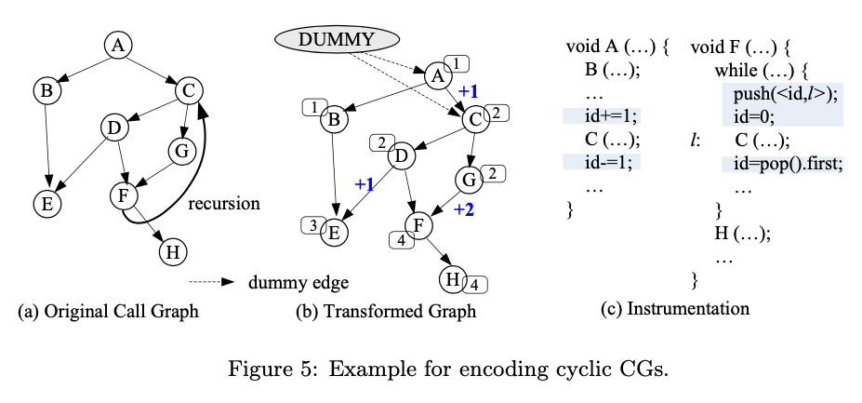
Encoding Cyclic Call Graph - PCCE
Stack (id, l)
3 | F->C
Call path: ACGFCDE
 | A | C | G | F | C | D | E
ID | 0 | 1 | 1 | 3 | 0 | 0 | 1

Slide 73
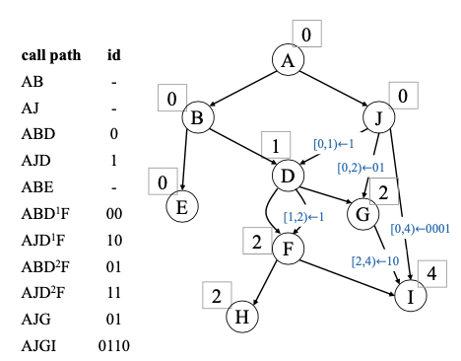
Encoding Acyclic Call Graph - Valence
Call Path: AJGI
 | BIT0 | BIT1 | BIT2 | BIT3
ID | 0 | 1 | 1 | 0
Edge label “[n,m) means “set bits n though m-1 in id to v”

Slide 74
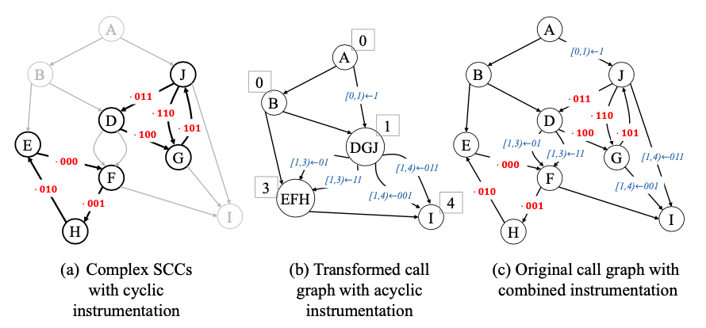
Encoding Cyclic Call Graph - Valence
Call Path: AJGJDFH
recID
asycID

Slide 75
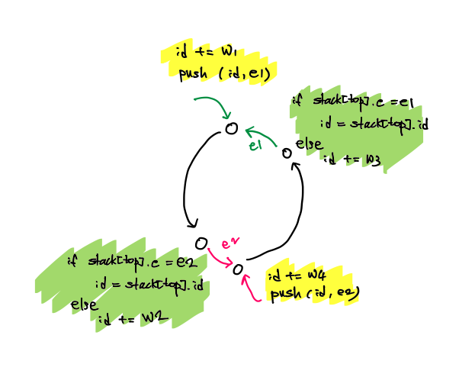
Encoding Cyclic Call Graph - DCCE

Slide 76
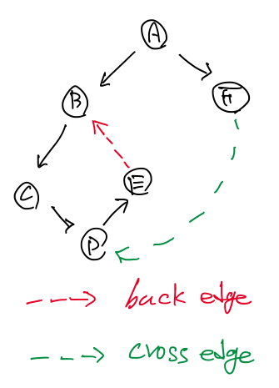
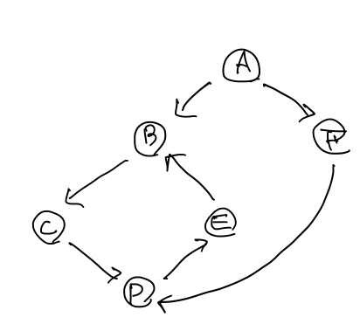
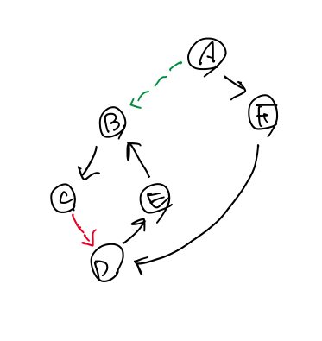
Limitation of DFS to find ALL backedges

Slide 77
How To Find back edges?
Donald B Johnson. "Finding all the elementary circuits of a directed graph." SIAM Journal on Computing. 1975.
https://github.com/qpwo/python-simple-cycles/blob/master/johnson.py

Slide 78
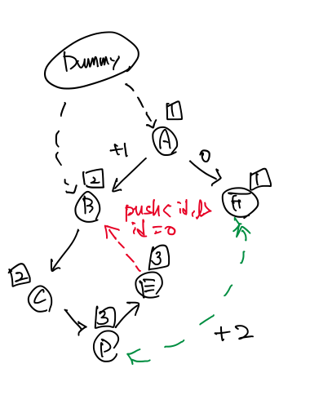
Issues with encoding cyclic CG (PCCE)
Call Path: AFDEB
ID
Stack (id, l)

Slide 79
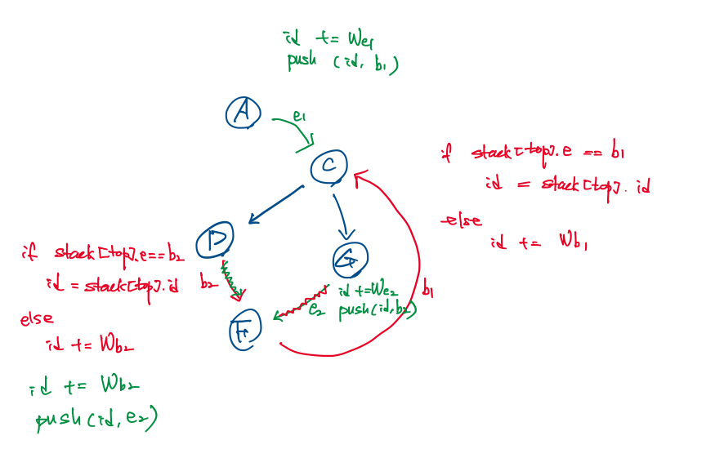
Issues with encoding cyclic CG (DCCE)

Slide 80
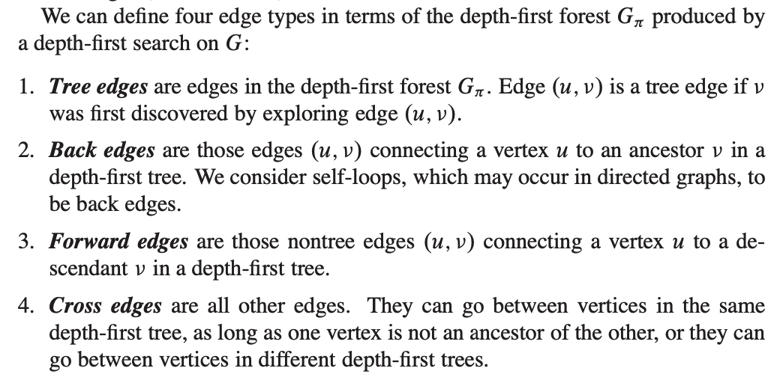
How To Find all back edges?

Slide 81
HW Security group
regular meeting
2021 March. 4

Slide 82
Agenda
Survey of CC Collection techniques with real applications and feasibility study of DCCE
WHISTLE
Notes:
What we’ve done so far: 1) Set up experiment environment (LLVM/SVF) 2) Impl. Acyclic encoding 3) Imp. Acyclic PCCE Encoding 4) Doing Cyclic Encoding - PCCE/DCCE
During work, I had a doubt
What application can use DCCE instead of existing tech.
Can DCCE performance better in terms of at least time overhead? (Is there other techniques rather than CC encoding?)
What aspect I should consider to be complete work?
Stop doing current action items, survey and study,
Find real apps that are using CC
Study CC used those real apps
Evalue DCCE if real apps can use DCCE
Find aspects, considerations that I should know for DCCE to be complete work
Finally, my conclusion is
I need more survey and study on CC collection and its use cases to clearly see the opportunity.
After complete the survey, we could see the opportunity or not
If we see that, go for it.
Otherwise, write a summary paper.
Regarding scheduling with WHISTLE,
Pause DCCE and Work on WHISTLE for MICRO submission
Resume after micro

Slide 83
Definition of Calling Context
The calling context (CC) of a given function invocation m, is path in the call graph (CG) leading from the root node to the node representing m.

Slide 84
CC Collection Tech.
On-demand Call Stack Unwinding (libunwind, HPCToolkit)
Stack shadowing (DeadSpy, CCTLib)
Existing CC encoding scheme (PCCE, Valence)
Distinguishable CE encoding (DCCE)
Notes:
We already knew three techniques, but did not study enough to compare each other qualitatively and quantitatively.
So far, I summarized them in terms of overhead of time to manage calling context.
And I found one more type of collection technique, stack shadowing, I'll introduce it and summarize with the same way

Slide 85
CC Collection Tech.
On-demand Call Stack Unwinding (libunwind, HPCToolkit)
Walks function frames on the call stack using
Compiler-recorded information (libunwind)
Results from binary analysis (HPCToolkit)
No instrumentation cost at each function call / return.
High overhead on demand for CC.
Suited for apps. with infrequent CC request.
Sampling-based performance tools and debugger.
Real example -
Barrier Elision for Production Parallel Programs
Watching for Software Inefficiencies with Witch

Slide 86
CC Collection Tech.
Stack Shadowing (DeadSpy, CCTLib)
Maintains Calling Context Tree as the execution unfolds.
Maintenance done by every function call and return.
Call path and its hashed value are ready to be used.
High overhead of maintenance.
A constant time lookup.
Suited for fine-grained execution monitoring (FEM) tools.
Track program execution at every machine instruction level.
Real app: DeadSpy, Runtime Value Numbering, RedSpy, LoadSpy, and WHISTLE.

Slide 87
CC Collection Tech.
(Existing) CC encoding schemes (PCCE, Valence).
Calling context encoding is to uniquely represent the current context of any execution point using a small number of integer identifiers (IDs)
Unwinding, shadowing can have ID by hashing.
IDs in the existing CC encoding scheme can only distinguish the different contexts with respect to the current node (NDCCID).
IDs in DCCE can distinguish the different contexts with respect to any nodes (DCCID).
Need function ID to be DCCID.
Extra overhead
Marking at callgraph? Reading something in the stack frame?
Not all call sites are instrumented to update ID.
Decoding cost depending on the length of the current call path.
Real app: Enabling Layer 2 Pathlet Tracing through Context Encoding in Software-Defined Networking

Slide 88
CC Collection Tech.
Distinguishable Calling Context Encoding
No cost to distinguish CCs.
All call sites are instrumented to update ID.
Not straightforward to design decoding algorithm with weight on incoming edge and MaxIDs of incidents.
At best, same cost of decoding as existing encoding schemes.
Suited for apps with highly frequent request for CCs.

Slide 89
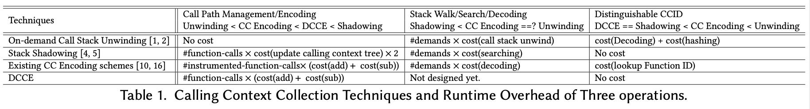
CC Collection Tech.

Slide 90
Real Applications-Barrier Elision for Production Parallel Programs
Problem: Large scientific parallel programs are written with conservative synchronization.
Due to several layers of libraries, multiple programming languages.
Idea: dynamic optimization to elide (skip) context sensitively redundant barriers.
A barrier is redundant if and only if skipping the operation introduces no data races.
executes the program alongside a dynamic data race detector, identify barriers by their calling context, determine if they are redundant in a particular context, then speculatively skip future executions in the same calling context.
Call stack unwinding is used to get CC and CC is hashed to encode.
Frequency of CC request is every time barrier is invoked at runtime.
500,000 barrier operations in their microbenchmark. (small or large?)
No need for call path.

Slide 91
Real Applications-DeadSpy, RedSpy, LoadSpy
Problem: Redundant operations are a common performance limiter.
Due to missed compiler optimization opportunities, inappropriate data structure/algorithm, developers’ inattention to performance.
Idea: a whole program profiler to pinpoint dead write(DeadSpy), and redundant computation (RedSpy), and redundant memory load(LoadSpy)
They require CC on each load or store operation.
Employ a unique 32-bit integer provided by CCTLib
Need DCCID during profile Need CC during report.
DCCE could perform better with these apps.

Slide 92
Real Applications-Enabling Layer 2 Pathlet Tracing through Context Encoding in Software-Defined Networking
Problem: Troubleshooting of SDN operations needs to verify whether the low-level actions performed by network devices conform to the high-level policies deployed by operators.
Idea: focus on path tracing, a specific operation for SDN troubleshooting that determines the Layer 2 path taken by a given packet.
Analogies between CC Encoding and Path encoding in SDN
Call graph of SW and topology of Network.
Call site and network switch.
Calling Context and network path.
Use PCCE and IDs are embedded to each packet.
Only request of network path (CC) in this application. No need for hashed CC.

Slide 93
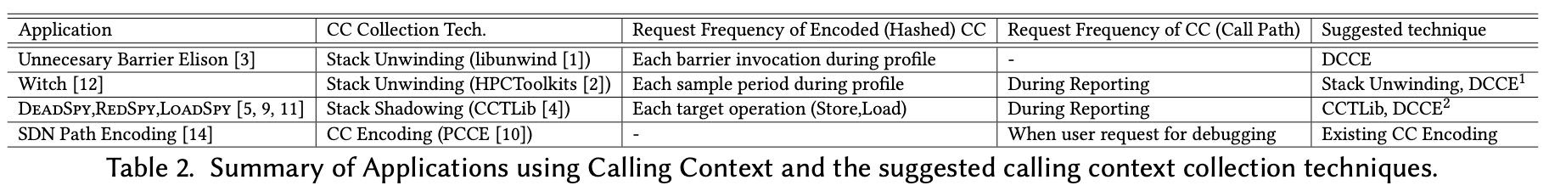
Real Applications and suggested techniques

Slide 94
Performance evaluation

Slide 95
Accuracy Evaluation
Recursive call.
Dynamic loaded libraries.
Multi-threaded program.
Exception handling.
Setjmp / longjmp.
Signal handling.
Attaching to a running process.
Function call identification in Optimized binary.

Slide 96
HW Security group
regular meeting
2021 March. 11

Slide 97
Topics
Calling Context Encoding
Survey of HW Supported CFI
Necessities, Design Choices
CFI Policies and its HW Supports
HW-Supported Runtime Calling Context ID Generation
Necessities,
Basic Idea and Components to extend
Existing HW-Supported tracing techniques.
Intel Processor Trace
Arm CoreSight
ToDos
WHISTLE
Think about static analysis for long term goal.
To show coverage, use SW profile with fuzzing/symbolic execution + HW profile only for profiling transient execution (selectively profile like important functions)
False negative - prove it is not technique not possible
Notes:
What we’ve done so far: 1) Set up experiment environment (LLVM/SVF) 2) Impl. Acyclic encoding 3) Imp. Acyclic PCCE Encoding 4) Doing Cyclic Encoding - PCCE/DCCE
During work, I had a doubt
What application can use DCCE instead of existing tech.
Can DCCE performance better in terms of at least time overhead? (Is there other techniques rather than CC encoding?)
What aspect I should consider to be complete work?
Stop doing current action items, survey and study,
Find real apps that are using CC
Study CC used those real apps
Evalue DCCE if real apps can use DCCE
Find aspects, considerations that I should know for DCCE to be complete work
Finally, my conclusion is
I need more survey and study on CC collection and its use cases to clearly see the opportunity.
After complete the survey, we could see the opportunity or not
If we see that, go for it.
Otherwise, write a summary paper.
Regarding scheduling with WHISTLE,
Pause DCCE and Work on WHISTLE for MICRO submission
Resume after micro

Slide 98
Need for hardware-based CFI
Runtime data can be compromised if they are stored in writable memory.
Data can be tampered by attackers.
SW protection - memory segmentation, Software-based Fault Isolation(SFI).
HW-based can provide strong isolation for runtime data structure and less overhead.
- Mauro Conti, Stephen Crane, Lucas Davi, Michael Franz, Per Larsen, Marco Negro, Christopher Liebchen, Mohaned Qunaibit, and Ahmad-Reza Sadeghi. 2015. Losing Control: On the Effectiveness of Control-Flow Integrity Under Stack Attacks. In Proceedings of the 22Nd ACM SIGSAC Conference on Computer and Communications Security (CCS ’15). ACM, New York, NY, USA, 952–963. https://doi.org/10.1145/2810103.2813671
- Isaac Evans, Sam Fingeret, Julian Gonzalez, Ulziibayar Otgonbaatar, Tiffany Tang, Howard Shrobe, Stelios Sidiroglou-Douskos, Martin Rinard, and Hamed Okhravi. 2015. Missing the Point(Er): On the Effectiveness of Code Pointer Integrity. In Proceedings of the 2015 IEEE Symposium on Security and Privacy (SP ’15). IEEE Computer Society, Washington, DC, USA, 781–796. https://doi.org/10.1109/SP.2015.53
Notes:
Memory segmentation provides effective isolation on x86-32, but is not really useful on x86-64 since segment limits are not enforced. Software-based Fault Isolation (SFI) executes additional guards to ensure that each store instruction can only write into a specific memory region. It is worth pointing out that instruction-level isolation techniques rely on the integrity of code.

Slide 99
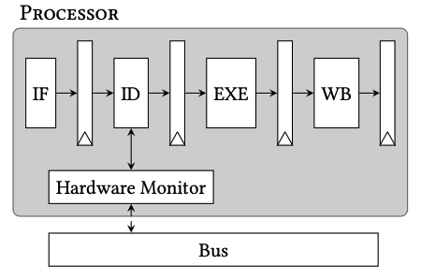
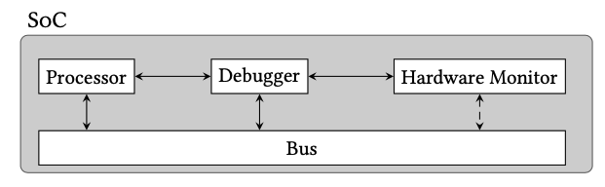
Design options
Integrating into a processor’s pipeline stage.
+) Can access all the runtime information.
-) Requires modification of existing processor.
Debug Interface.
Connect off-chip microprocessor, ASIC, or FPGA to the external debug interface.
+) No changes in the processor.
-) limited to access all the required runtime information.
Notes:
3.3.1 Processor’s pipeline stage. Many architectures integrate their hardware monitor into one or more of the processor’s instruction pipeline stages, as shown in Fig. 1. This allows all the processor’s internal signals to be exploited for enforcing the CFI policy. For example, many CFI policies require runtime branch information such as the branch source address, target address, and branch type. To enforce CFI, the required signals can be forwarded from inside the appropriate pipeline stage to the hardware monitor, which uses this information to verify the validity of each branch.
Another approach is to add special instructions to the ISA to enforce a CFI policy. This also requires modification of pipeline stage(s), such as the Instruction Decode (ID) stage. In order to make use of the special instructions, a software toolchain is often used to insert these special instruction into the compiled software.
In Fig. 1 the hardware monitor is integrated with the "ID" pipeline stage. However, the monitor can be integrated into multiple different pipeline stages. The decision on where to integrate the monitor depends on the availability of information at a given stage.
See Section 6 for a presentation on the state-of-the-art in CFI architectures that are integrated into the pipeline stages of the processor.
The biggest disadvantage of integrating a monitor into the pipeline stages is that it does not follow the typical System-on-Chip (SoC) design flow, as it requires modification of existing Intellectual Property (IP), such as the processor.
3.3.2 Debug interface. Some recent works exploit the processor hardware debug interface to monitor a program’s behavior without modifying the processor or other pre-existing IP, as shown in Fig. 2. This is a major advantage, as it complies with the design rules of SoCs. Modifying IP is expensive, as it requires modification by the IP vendor (expensive), or requires the IP vendor to release its Hardware Description Language (HDL) to the client (even more expensive). Monitors which are realized by hardware-based standalone IP are practical, because they do not require the modification of the target processor, but simply communicate with the target processor via existing interfaces, such as the processor’s hardware debug port or the bus.
A major challenge with enforcing CFI through the debug interface, is to obtain access to all the required runtime information. Since the hardware debugger is designed for debugging purposes, it usually does not provide all the necessary information to enforce a given protection mechanism. A common approach to solve this is to provide supplementary metadata inside main memory, or to communicate the missing information by instrumenting the binary to write the required information to memory-mapped addresses (MMIO).
Some SoCs have an external debug interface, which facilitates the use of an external hardware monitor. In this case the monitor can be realized by an off-chip microprocessor or other dedicated hardware (FPGA or ASIC), which are connected to the external debug interface.
See Section 7 for a presentation on the state-of-the-art in CFI architectures which monitor the processor via the hardware debug interface.

Slide 100

Labels - indirect forward branch
Correctness of the destination basic block(BB) is verified before every indirect branch using label ID.
Insert ID at the beginning of each BB.
Before each indirect branch, the destination BB’s ID is compared to a set of IDs storing possible destination BBs.
ISA extension.
SetLabel: assign a new ID to the label register before branch.
CheckLabel: verify ID in label register
Limitations of static CFI
Multiple different indirect branches target the many common BB.
Context-sensitive CFI
Last Branch Record(Intel LBR) - PathArmor
Per-input - πCFI
Path (Intel PT) - PittyPat
Call Stack (Return Addr) - CFI-LB
Origin-Sensitive - OS-CFI
[CODASPY'16] HCFI: Hardware-enforced Control-Flow Integrity.
[DAC’16] Strategy Without Tactics: Policy-agnostic Hardware- enhanced Control-flow Integrity.
[USENIX’15] Control-Flow Bending: On the Effectiveness of Control-Flow Integrity.
[CCS'15] Practical Context-Sensitive CFI (PathArmor)
[CCS'15] Per-Input Control-Flow Integrity (πCFI)
[USENIX'17] Efficient Protection of Path-Sensitive Control Security (Pitty Pat)
[EuroS&P’19] Adaptive Call-site Sensitive Control Flow Integrity (CFI-LB)
[USENIX'19] Origin-sensitive Control Flow Integrity

Slide 101

Shadow Call Stack (SCS) - backward edge
Backward Edge(ret) hijacking cannot be protected by Label.
Call pushes the return address on both the data and shadow stack.
Ret pops the return address from both stacks and compares them.
If not match, raise an exception.
Challenges
Buffer Size. (Maximum call depth of 238, 16~32 entries)
Protecting Runtime Data.
Intel CET - special “SCS” pages (regular store inst. cannot modify).
Rely on memory allocated in kernel space to ensure that SCS is separated from the processor’s memory space.
Lee et al. - Protected by snooping traffic bet. Processor and memory controller
Multithreading environment
Store PID in SCS entry (Davi et al).
Relax CFI policy by allowing returns to target any address stored in SCS (Das et al).
Practical Issues
Precise CFG, Unintended branches, Setjmp/Longjmp
- Yongje Lee, Jinyong Lee, Ingoo Heo, Dongil Hwang, and Yunheung Paek. 2017. Using CoreSight PTM to Integrate CRA Monitoring IPs in an ARM-Based SoC. ACM Trans. Des. Autom. Electron. Syst. 22, 3, Article 52 (April 2017), 25 pages. https://doi.org/10.1145/3035965
- Intel CET - https://software.intel.com/sites/default/files/managed/4d/2a/ control-flow-enforcement-technology-preview.pdf.
- Hilmi Ozdoganoglu, T. N. Vijaykumar, Carla E. Brodley, Benjamin A. Kuperman, and Ankit Jalote. 2006. SmashGuard: A Hardware Solution to Prevent Security Attacks on the Function Return Address. IEEE Trans. Comput. 55, 10 (Oct. 2006), 1271–1285. https://doi.org/10.1109/TC.2006.166
- Lucas Davi, Matthias Hanreich, Debayan Paul, Ahmad-Reza Sadeghi, Patrick Koeberl, Dean Sullivan, Orlando Arias, and Yier Jin. 2015. HAFIX: Hardware-assisted Flow Integrity Extension. In Proceedings of the 52Nd Annual Design Automation Conference (DAC ’15). ACM, New York, NY, USA, 74:1–74:6.
- Sanjeev Das, Wei Zhang, and Yang Liu. 2016. A Fine-Grained Control Flow Integrity Approach Against Runtime Memory Attacks for Embedded Systems. IEEE Trans. Very Large Scale Integr. Syst. 24, 11 (Nov. 2016), 3193–3207. https://doi.org/10.1109/TVLSI.2016.2548561

Slide 102



Shadow Stack alternative - backward edge
CFIBR: activates the function by loading the label to dedicated memory.
CFIDEL: deactivates the function by remove the label.
CFIRET: checks if a label is active.
Compiler
assigns label to each function.
forces CFIBR to be the first instruction of each function.
forces CFIDEL to be executed just before return.
Integrated to the processor pipeline stages.
CFI Control logics
the label state memory (16384x1 buffer)
Lucas Davi, Matthias Hanreich, Debayan Paul, Ahmad-Reza Sadeghi, Patrick Koeberl, Dean Sullivan, Orlando Arias, and Yier Jin. 2015. HAFIX: Hardware-assisted Flow Integrity Extension. In Proceedings of the 52Nd Annual Design Automation Conference (DAC ’15). ACM, New York, NY, USA, 74:1–74:6.

Slide 103
Other CFI Approaches
Table - allowed branches (source addr, dest addr)
Single entry for each direct branch, Multiple entries for each indirect branch
Fine-grained, static CFI
Large storage requirement, performance penalty
Finite State Machine
Interprocedural CFI (Function calls)
Interprocedural CFI (basic blocks)
Detect Invalid system call sequence
Heuristics - detects CRA signatures from the branching behavior
Monitoring graph(MG)
The expected program behavior, called a monitoring graph, is generated through analysis and simulation, and is then stored in memory. At runtime, the derived stream is compared to the monitoring graph.
Patterns of address, opcode, load, store, control flow, hash of opcde, and PC.
- Z. Guo, R. Bhakta, and I. G. Harris. 2014. Control-flow checking for intrusion detection via a real-time debug interface. In 2014 International Conference on Smart Computing Workshops. 87–92.
- Divya Arora, Srivaths Ravi, Anand Raghunathan, and Niraj K. Jha. 2006. Hardware-assisted Run-time Monitoring for Secure Program Execution on Embedded Processors. IEEE Trans. Very Large Scale Integr. Syst. 14, 12 (Dec. 2006), 1295–1308. https://doi.org/10.1109/TVLSI.2006.887799
- Mehryar Rahmatian, Hessam Kooti, Ian G. Harris, and Elaheh Bozorgzadeh. 2012. Hardware-Assisted Detection of Malicious Software in Embedded Systems. IEEE Embed. Syst. Lett. 4, 4 (Dec. 2012), 94–97. https://doi.org/10.1109/LES.2012.2218630
- Shufu Mao and Tilman Wolf. 2010. Hardware support for secure processing in embedded systems. Computers, IEEE Transactions on 59, 6 (2010), 847–854.

Slide 104

Inter- Intra procedural Control Flow Integrity
- Z. Guo, R. Bhakta, and I. G. Harris. 2014. Control-flow checking for intrusion detection via a real-time debug interface. In 2014 International Conference on Smart Computing Workshops. 87–92.
- Divya Arora, Srivaths Ravi, Anand Raghunathan, and Niraj K. Jha. 2006. Hardware-assisted Run-time Monitoring for Secure Program Execution on Embedded Processors. IEEE Trans. Very Large Scale Integr. Syst. 14, 12 (Dec. 2006), 1295–1308. https://doi.org/10.1109/TVLSI.2006.887799

Slide 105


Other CFI Approaches
Branch Regulation (BR)
Invariant based
Call always targets a function entry point
Indirect jmp targets either a function entry or an address within the current function.
Limits JOP attacks
+) requires no CFG, lightweight
Branch Regulation on Basic Blocks (BR on BB)
Restricting jmp targets to the current function boundary (as was done in BR) is too restrictive, as it cannot support longjmp().
Call is allowed to target the first basic block of a function
Inject jmp are allowed to target the first instruction inside a basic block.
- Mehmet Kayaalp, Meltem Ozsoy, Nael Abu Ghazaleh, and Dmitry Ponomarev. 2014. Efficiently securing systems from code reuse attacks. Computers, IEEE Transactions on 63, 5 (2014), 1144–1156.
- Sanjeev Das, Wei Zhang, and Yang Liu. 2016. A Fine-Grained Control Flow Integrity Approach Against Runtime Memory Attacks for Embedded Systems. IEEE Trans. Very Large Scale Integr. Syst. 24, 11 (Nov. 2016), 3193–3207. https://doi.org/10.1109/TVLSI.2016.2548561

Slide 106
Other CFI Approaches
Branch Limitation (BL)
Limits branch target to basic block entries
ENDBRANCH in Intel CET
Instruction Set Randomization (ISR)
Instruction’s bytes are encrypted offline
Decrypted using a combination of the current and previous program counters at runtime.
Invalid control flow between two instructions will lead to a decryption error.
Signature Modeling (SM)
A checksum is periodically calculated on the executed instructions for comparison with stored reference values.
Code Pointer Integrity (CPI)
Pointer Authentication Codes (PACs) are used to verify the integrity of pointers at runtime.
PAC is calculated over the pointer target together with a context.
- Wenjian He, Sanjeev Das, Wei Zhang, and Yang Liu. 2017. No-Jump-into-Basic-Block: Enforce Basic Block CFI on the Fly for Real-world Binaries. In Proceedings of the 54th Annual Design Automation Conference 2017 (DAC ’17). ACM, New York, NY, USA, Article 23, 6 pages. https: //doi.org/10.1145/3061639.3062291
- Intel. 2017. Intel Control-flow Enforcement Technology Preview. https://software.intel.com/sites/default/files/managed/4d/2a/ control-flow-enforcement-technology-preview.pdf. (2017). [Online; accessed 19-Jun-2017].
- Ruan de Clercq, Johannes Götzfried, Ü"bler David, Pieter Maene, and Ingrid Verbauwhede. 2017. SOFIA: Software and Control Flow Integrity Architecture. In Computers & Security, Vol. 68. 16–35. https://doi.org/10.1016/j.cose.2017.03.013
- K. Wilken and J. P. Shen. 1988. Continuous signature monitoring: efficient concurrent-detection of processor control errors. In International Test Conference 1988 Proceeding. 914–925. https://doi.org/10.1109/TEST.1988.207880
- A. Mahmood and E. J. McCluskey. 1988. Concurrent Error Detection Using Watchdog Processors-A Survey. IEEE Trans. Comput. 37, 2 (Feb. 1988), 160–174. https://doi.org/10.1109/12.2145
- 2017. Pointer Authentication on ARMv8.3. Qualcomm Technologies, Inc. (2017).

Slide 107
HW Supported Runtime Calling Context ID Generation
For applications that want to DISTINGUISH CC at runtime.
Some apps does not need to manage CC at runtime.
They require CC after analysis, debug, profile, etc. (decoding doesn’t require high speed)
Existing CC collection tech. are all software based.
Stack unwinding, Stack Shadowing, CC Enc/Dec.
HW Assisted Tracing (Intel Processor Trace, Arm CoreSight) are designed for postmortem analysis.
Idea: Provide CCID register that stores the identifier of the current calling context.
It can reduce overhead to
maintain CCs and hashing it. (Stack Unwinding, Stack Shadowing)
maintain function ID and associating with encodings (CC Encoding schemes).
Compare to HW supported CFI,
It is a new debug info not a security mitigation such as CFI.

Slide 108
HW Supported Runtime Calling Context ID Generation
Compiler
Generates call graph and calculates weight of each edge.
Use special instruction call_cc / ret_cc with weight to update CCID register.
HW
Provides CCID register.
Call_cc callee weight: adds weight to CCID register.
For recursive call, Push current CCID to Shadow CCID Stack or restore CCID from stack.
Ret_cc weight: subtract weight from CCID register, pop CCID from shadow CCID stack.
User space can only read CCID register.
Written by only call_cc and ret_cc
Need code integrity
SW-based application use CCID register with help of instrumentation tool
HW-based application use CCID register through debug interface.

Slide 109

- https://sites.google.com/site/intelptmicrotutorial/downloads
Notes:
Memory segmentation provides effective isolation on x86-32, but is not really useful on x86-64 since segment limits are not enforced. Software-based Fault Isolation (SFI) executes additional guards to ensure that each store instruction can only write into a specific memory region. It is worth pointing out that instruction-level isolation techniques rely on the integrity of code.

Slide 110

- https://sites.google.com/site/intelptmicrotutorial/downloads
Notes:
Memory segmentation provides effective isolation on x86-32, but is not really useful on x86-64 since segment limits are not enforced. Software-based Fault Isolation (SFI) executes additional guards to ensure that each store instruction can only write into a specific memory region. It is worth pointing out that instruction-level isolation techniques rely on the integrity of code.

Slide 111

- https://sites.google.com/site/intelptmicrotutorial/downloads
Notes:
Memory segmentation provides effective isolation on x86-32, but is not really useful on x86-64 since segment limits are not enforced. Software-based Fault Isolation (SFI) executes additional guards to ensure that each store instruction can only write into a specific memory region. It is worth pointing out that instruction-level isolation techniques rely on the integrity of code.

Slide 112

- https://sites.google.com/site/intelptmicrotutorial/downloads
Notes:
Memory segmentation provides effective isolation on x86-32, but is not really useful on x86-64 since segment limits are not enforced. Software-based Fault Isolation (SFI) executes additional guards to ensure that each store instruction can only write into a specific memory region. It is worth pointing out that instruction-level isolation techniques rely on the integrity of code.

Slide 113


ARM CoreSite
- https://elinux.org/images/b/b3/Hardware_Assisted_Tracing_on_ARM.pdf
- https://www.youtube.com/watch?v=Gm2ZXIB18PQ
Notes:
Memory segmentation provides effective isolation on x86-32, but is not really useful on x86-64 since segment limits are not enforced. Software-based Fault Isolation (SFI) executes additional guards to ensure that each store instruction can only write into a specific memory region. It is worth pointing out that instruction-level isolation techniques rely on the integrity of code.

Slide 114
- https://sites.google.com/site/intelptmicrotutorial/downloads
Notes:
Memory segmentation provides effective isolation on x86-32, but is not really useful on x86-64 since segment limits are not enforced. Software-based Fault Isolation (SFI) executes additional guards to ensure that each store instruction can only write into a specific memory region. It is worth pointing out that instruction-level isolation techniques rely on the integrity of code.

Slide 115

https://www.youtube.com/watch?v=pDF09K3753k
Notes:
Memory segmentation provides effective isolation on x86-32, but is not really useful on x86-64 since segment limits are not enforced. Software-based Fault Isolation (SFI) executes additional guards to ensure that each store instruction can only write into a specific memory region. It is worth pointing out that instruction-level isolation techniques rely on the integrity of code.

Slide 116

- https://sites.google.com/site/intelptmicrotutorial/downloads
Notes:
Memory segmentation provides effective isolation on x86-32, but is not really useful on x86-64 since segment limits are not enforced. Software-based Fault Isolation (SFI) executes additional guards to ensure that each store instruction can only write into a specific memory region. It is worth pointing out that instruction-level isolation techniques rely on the integrity of code.

Slide 117

CRA Monitor using CoreSight
Yongje Lee, Jinyong Lee, Ingoo Heo, Dongil Hwang, and Yunheung Paek. 2017. Using CoreSight PTM to Integrate CRA Monitoring IPs in an ARM-Based SoC. ACM Trans. Des. Autom. Electron. Syst. 22, 3, Article 52 (April 2017), 25 pages. https://doi.org/10.1145/3035965

Slide 118
ToDos
Complete Cyclic CG.
Address indirect call.
Check how SVF does points-to analysis (PTA)
Address practical issues.
Stack Size, Setjmp/Longjmp(Exception), multi-threaded program, unintended branch,
Evaluations
Static stats
#nodes, #edges, #cycles, #func-ptrs, Max Neighbors, Max Incidents, Max cycle length, Max call path length, MaxID, etc
Dynamic stats
#contexts, Max call path length
Sensitivity study of shadow CCID buffer.
Runtime speedup of target applications
Apps w/ existing tech. vs. SW-DCCE vs. HW-DCCE.

Slide 119
ToDos
Implementation
Simulator - need suggestions.
Extend Compiler using LLVM to support new instructions.
Extend processor’s pipeline stage.
Duplicate/Modify applications to use CCID register.
Target Apps.
DeadSpy,RedSpy,LoadSp
https://github.com/CCTLib/cctlib/blob/master/clients/loadspy_client.cpp
Barrier Elision

Slide 120

Shadow Call Stack (SCS)
Yongje Lee, Jinyong Lee, Ingoo Heo, Dongil Hwang, and Yunheung Paek. 2017. Using CoreSight PTM to Integrate CRA Monitoring IPs in an ARM-Based SoC. ACM Trans. Des. Autom. Electron. Syst. 22, 3, Article 52 (April 2017), 25 pages. https://doi.org/10.1145/3035965

Slide 121

Dynamic Information Flow Tracking
[DAC'15] Efficient Security Monitoring with the Core Debug Interface in an Embedded Processor

Slide 122
Inter- Intra procedural Control Flow
Integrated into the pipeline stages of the processor.
HW components - FSMs, lookup tables, buffer, a hash engine, and control logic.
Maximum area overhead - 1.2 % (Interprocedural), 5.17%(Inter+Intra), 9.1% (Inter+Intra+Hash)
- Z. Guo, R. Bhakta, and I. G. Harris. 2014. Control-flow checking for intrusion detection via a real-time debug interface. In 2014 International Conference on Smart Computing Workshops. 87–92.
- Divya Arora, Srivaths Ravi, Anand Raghunathan, and Niraj K. Jha. 2006. Hardware-assisted Run-time Monitoring for Secure Program Execution on Embedded Processors. IEEE Trans. Very Large Scale Integr. Syst. 14, 12 (Dec. 2006), 1295–1308. https://doi.org/10.1109/TVLSI.2006.887799

Slide 123
HW Security group
regular meeting
June 3 2022

Slide 124
Topics
DrCCTLibProf (Goal: replace CCT with DCCE)
Overhead
Max Context Handle
DrCCTLibProf initialization with a ccid client
Does recursive function calls make different handle?
Does a function call in a loop make different handle?
Does DrCCTLibProf guarantee the same handle for different runs?
Does the same function call from different callsite make different handle?
Why clients can’t print a backtrace in the middle of profile?
Notes:
What we’ve done so far: 1) Set up experiment environment (LLVM/SVF) 2) Impl. Acyclic encoding 3) Imp. Acyclic PCCE Encoding 4) Doing Cyclic Encoding - PCCE/DCCE
During work, I had a doubt
What application can use DCCE instead of existing tech.
Can DCCE performance better in terms of at least time overhead? (Is there other techniques rather than CC encoding?)
What aspect I should consider to be complete work?
Stop doing current action items, survey and study,
Find real apps that are using CC
Study CC used those real apps
Evalue DCCE if real apps can use DCCE
Find aspects, considerations that I should know for DCCE to be complete work
Finally, my conclusion is
I need more survey and study on CC collection and its use cases to clearly see the opportunity.
After complete the survey, we could see the opportunity or not
If we see that, go for it.
Otherwise, write a summary paper.
Regarding scheduling with WHISTLE,
Pause DCCE and Work on WHISTLE for MICRO submission
Resume after micro

Slide 125

Overhead
Spec 2017 with reference input
Base: A client without drcctlib_init
DrCCTLibProf: A client with FILTER_ZERO_INSTR (Overhead of Call/Ret)
Notes:
What we’ve done so far: 1) Set up experiment environment (LLVM/SVF) 2) Impl. Acyclic encoding 3) Imp. Acyclic PCCE Encoding 4) Doing Cyclic Encoding - PCCE/DCCE
During work, I had a doubt
What application can use DCCE instead of existing tech.
Can DCCE performance better in terms of at least time overhead? (Is there other techniques rather than CC encoding?)
What aspect I should consider to be complete work?
Stop doing current action items, survey and study,
Find real apps that are using CC
Study CC used those real apps
Evalue DCCE if real apps can use DCCE
Find aspects, considerations that I should know for DCCE to be complete work
Finally, my conclusion is
I need more survey and study on CC collection and its use cases to clearly see the opportunity.
After complete the survey, we could see the opportunity or not
If we see that, go for it.
Otherwise, write a summary paper.
Regarding scheduling with WHISTLE,
Pause DCCE and Work on WHISTLE for MICRO submission
Resume after micro

Slide 126
Overhead
[drcctlib[fwk](hpcserver.cse.tamu.edu5493) msg]====Preallocated IPNodes exhausted. CCTLib couldn't fit your application in its memory. Try a smaller program.
Notes:
What we’ve done so far: 1) Set up experiment environment (LLVM/SVF) 2) Impl. Acyclic encoding 3) Imp. Acyclic PCCE Encoding 4) Doing Cyclic Encoding - PCCE/DCCE
During work, I had a doubt
What application can use DCCE instead of existing tech.
Can DCCE performance better in terms of at least time overhead? (Is there other techniques rather than CC encoding?)
What aspect I should consider to be complete work?
Stop doing current action items, survey and study,
Find real apps that are using CC
Study CC used those real apps
Evalue DCCE if real apps can use DCCE
Find aspects, considerations that I should know for DCCE to be complete work
Finally, my conclusion is
I need more survey and study on CC collection and its use cases to clearly see the opportunity.
After complete the survey, we could see the opportunity or not
If we see that, go for it.
Otherwise, write a summary paper.
Regarding scheduling with WHISTLE,
Pause DCCE and Work on WHISTLE for MICRO submission
Resume after micro

Slide 127

Max Context Handle
 | Max Context Handle
perlbench_s | 473,465
gcc_s | 16,777,216
mcf_s | 7,789
cactuBSSN_s | 603,451
lbm_s | 942
omnetpp_s | 236,131
xalancbmk_s | 155,950
x264_s | 44,151
Deepsjeng_ | 16,777,216
imagick_s | 49,506
leela_s | 7,860,845
nab_s | 7,987
xz_s | 954
Notes:
What we’ve done so far: 1) Set up experiment environment (LLVM/SVF) 2) Impl. Acyclic encoding 3) Imp. Acyclic PCCE Encoding 4) Doing Cyclic Encoding - PCCE/DCCE
During work, I had a doubt
What application can use DCCE instead of existing tech.
Can DCCE performance better in terms of at least time overhead? (Is there other techniques rather than CC encoding?)
What aspect I should consider to be complete work?
Stop doing current action items, survey and study,
Find real apps that are using CC
Study CC used those real apps
Evalue DCCE if real apps can use DCCE
Find aspects, considerations that I should know for DCCE to be complete work
Finally, my conclusion is
I need more survey and study on CC collection and its use cases to clearly see the opportunity.
After complete the survey, we could see the opportunity or not
If we see that, go for it.
Otherwise, write a summary paper.
Regarding scheduling with WHISTLE,
Pause DCCE and Work on WHISTLE for MICRO submission
Resume after micro

Slide 128

DrCCTLib initialization
Can’t register a call back for only call and ret
Create a new filter DRCCTLIB_FILTER_CALL_RET_INSTR
Notes:
What we’ve done so far: 1) Set up experiment environment (LLVM/SVF) 2) Impl. Acyclic encoding 3) Imp. Acyclic PCCE Encoding 4) Doing Cyclic Encoding - PCCE/DCCE
During work, I had a doubt
What application can use DCCE instead of existing tech.
Can DCCE performance better in terms of at least time overhead? (Is there other techniques rather than CC encoding?)
What aspect I should consider to be complete work?
Stop doing current action items, survey and study,
Find real apps that are using CC
Study CC used those real apps
Evalue DCCE if real apps can use DCCE
Find aspects, considerations that I should know for DCCE to be complete work
Finally, my conclusion is
I need more survey and study on CC collection and its use cases to clearly see the opportunity.
After complete the survey, we could see the opportunity or not
If we see that, go for it.
Otherwise, write a summary paper.
Regarding scheduling with WHISTLE,
Pause DCCE and Work on WHISTLE for MICRO submission
Resume after micro

Slide 129
DrCCTLib context handle
Does recursive function calls make different handle?
Yes
DCCE: Yes
Notes:
x86.hpcserver.cse.tamu.edu-32729.max_ccid.out

Slide 130
DrCCTLib context handle
Does a function call in a loop make different handle?
No (except the first call)
DCCE: No (every call)
Notes:
x86.hpcserver.cse.tamu.edu-33952.max_ccid.out

Slide 131
DrCCTLib context handle
Does DrCCTLibProf guarantee the same handle for different runs?
Yes
Barrier elision type of application can’t use this tool
DCCE? -> No with static call graph
How to handle indirect call?
Notes:
x86.hpcserver.cse.tamu.edu-39949.max_ccid.out
x86.hpcserver.cse.tamu.edu-39950.max_ccid.out

Slide 132
DrCCTLib context handle
Does the same function call from different callsite make different handle?
Yes
DCCE: Yes
Notes:
x86.hpcserver.cse.tamu.edu-39949.max_ccid.out
x86.hpcserver.cse.tamu.edu-39950.max_ccid.out

Slide 133

DrCCTLib initialization
Why clients can’t print a backtrace in the middle of profile
Notes:
x86.hpcserver.cse.tamu.edu-39949.max_ccid.out
x86.hpcserver.cse.tamu.edu-39950.max_ccid.out

Slide 134
Next plan
Keep working on replacement CCT with DCCE
Integration Call graph (generated by LLVM) to DynamoRIo
Notes:
x86.hpcserver.cse.tamu.edu-39949.max_ccid.out
x86.hpcserver.cse.tamu.edu-39950.max_ccid.out

Slide 135
HW Security group
regular meeting
June 10 2022

Slide 136
Topics
DrCCTLibProf (Goal: replace CCT with DCCE)
Overhead
Max Context Handle (DCCE/PCCE/DrCCTLibProf)
Code review and replace CCT with DCCE
Notes:
What we’ve done so far: 1) Set up experiment environment (LLVM/SVF) 2) Impl. Acyclic encoding 3) Imp. Acyclic PCCE Encoding 4) Doing Cyclic Encoding - PCCE/DCCE
During work, I had a doubt
What application can use DCCE instead of existing tech.
Can DCCE performance better in terms of at least time overhead? (Is there other techniques rather than CC encoding?)
What aspect I should consider to be complete work?
Stop doing current action items, survey and study,
Find real apps that are using CC
Study CC used those real apps
Evalue DCCE if real apps can use DCCE
Find aspects, considerations that I should know for DCCE to be complete work
Finally, my conclusion is
I need more survey and study on CC collection and its use cases to clearly see the opportunity.
After complete the survey, we could see the opportunity or not
If we see that, go for it.
Otherwise, write a summary paper.
Regarding scheduling with WHISTLE,
Pause DCCE and Work on WHISTLE for MICRO submission
Resume after micro

Slide 137
Overhead (FOR_SPEC_TEST not defined)
[drcctlib[fwk](hpcserver.cse.tamu.edu5493) msg]====Preallocated IPNodes exhausted. CCTLib couldn't fit your application in its memory. Try a smaller program.
Notes:
What we’ve done so far: 1) Set up experiment environment (LLVM/SVF) 2) Impl. Acyclic encoding 3) Imp. Acyclic PCCE Encoding 4) Doing Cyclic Encoding - PCCE/DCCE
During work, I had a doubt
What application can use DCCE instead of existing tech.
Can DCCE performance better in terms of at least time overhead? (Is there other techniques rather than CC encoding?)
What aspect I should consider to be complete work?
Stop doing current action items, survey and study,
Find real apps that are using CC
Study CC used those real apps
Evalue DCCE if real apps can use DCCE
Find aspects, considerations that I should know for DCCE to be complete work
Finally, my conclusion is
I need more survey and study on CC collection and its use cases to clearly see the opportunity.
After complete the survey, we could see the opportunity or not
If we see that, go for it.
Otherwise, write a summary paper.
Regarding scheduling with WHISTLE,
Pause DCCE and Work on WHISTLE for MICRO submission
Resume after micro

Slide 138
Overhead (FOR_SPEC_TEST defined)
Notes:
What we’ve done so far: 1) Set up experiment environment (LLVM/SVF) 2) Impl. Acyclic encoding 3) Imp. Acyclic PCCE Encoding 4) Doing Cyclic Encoding - PCCE/DCCE
During work, I had a doubt
What application can use DCCE instead of existing tech.
Can DCCE performance better in terms of at least time overhead? (Is there other techniques rather than CC encoding?)
What aspect I should consider to be complete work?
Stop doing current action items, survey and study,
Find real apps that are using CC
Study CC used those real apps
Evalue DCCE if real apps can use DCCE
Find aspects, considerations that I should know for DCCE to be complete work
Finally, my conclusion is
I need more survey and study on CC collection and its use cases to clearly see the opportunity.
After complete the survey, we could see the opportunity or not
If we see that, go for it.
Otherwise, write a summary paper.
Regarding scheduling with WHISTLE,
Pause DCCE and Work on WHISTLE for MICRO submission
Resume after micro

Slide 139

Max Context Handle
Notes:
What we’ve done so far: 1) Set up experiment environment (LLVM/SVF) 2) Impl. Acyclic encoding 3) Imp. Acyclic PCCE Encoding 4) Doing Cyclic Encoding - PCCE/DCCE
During work, I had a doubt
What application can use DCCE instead of existing tech.
Can DCCE performance better in terms of at least time overhead? (Is there other techniques rather than CC encoding?)
What aspect I should consider to be complete work?
Stop doing current action items, survey and study,
Find real apps that are using CC
Study CC used those real apps
Evalue DCCE if real apps can use DCCE
Find aspects, considerations that I should know for DCCE to be complete work
Finally, my conclusion is
I need more survey and study on CC collection and its use cases to clearly see the opportunity.
After complete the survey, we could see the opportunity or not
If we see that, go for it.
Otherwise, write a summary paper.
Regarding scheduling with WHISTLE,
Pause DCCE and Work on WHISTLE for MICRO submission
Resume after micro

Slide 140

Max Context Handle (DrCCTLibProf/DCCE/PCCE)
PCCE – non-recursive version can’t handle correctly
Bigger MaxID: indirect call
Smaller MaxID: Dynamic library?
Notes:
What we’ve done so far: 1) Set up experiment environment (LLVM/SVF) 2) Impl. Acyclic encoding 3) Imp. Acyclic PCCE Encoding 4) Doing Cyclic Encoding - PCCE/DCCE
During work, I had a doubt
What application can use DCCE instead of existing tech.
Can DCCE performance better in terms of at least time overhead? (Is there other techniques rather than CC encoding?)
What aspect I should consider to be complete work?
Stop doing current action items, survey and study,
Find real apps that are using CC
Study CC used those real apps
Evalue DCCE if real apps can use DCCE
Find aspects, considerations that I should know for DCCE to be complete work
Finally, my conclusion is
I need more survey and study on CC collection and its use cases to clearly see the opportunity.
After complete the survey, we could see the opportunity or not
If we see that, go for it.
Otherwise, write a summary paper.
Regarding scheduling with WHISTLE,
Pause DCCE and Work on WHISTLE for MICRO submission
Resume after micro

Slide 141


Callgraph with indirect call by SVF
Notes:
What we’ve done so far: 1) Set up experiment environment (LLVM/SVF) 2) Impl. Acyclic encoding 3) Imp. Acyclic PCCE Encoding 4) Doing Cyclic Encoding - PCCE/DCCE
During work, I had a doubt
What application can use DCCE instead of existing tech.
Can DCCE performance better in terms of at least time overhead? (Is there other techniques rather than CC encoding?)
What aspect I should consider to be complete work?
Stop doing current action items, survey and study,
Find real apps that are using CC
Study CC used those real apps
Evalue DCCE if real apps can use DCCE
Find aspects, considerations that I should know for DCCE to be complete work
Finally, my conclusion is
I need more survey and study on CC collection and its use cases to clearly see the opportunity.
After complete the survey, we could see the opportunity or not
If we see that, go for it.
Otherwise, write a summary paper.
Regarding scheduling with WHISTLE,
Pause DCCE and Work on WHISTLE for MICRO submission
Resume after micro

Slide 142
Comments
DrCCTLibProf (Goal: replace CCT with DCCE)
Overhead
Max Context Handle (DCCE/PCCE/DrCCTLibProf)
Code review and replace CCT with DCCE
SVF+LLVM Callgraph integration to DynamoRIO
Map IDs of caller/callee/callsite from SVF to DynamoRIO
Notes:
What we’ve done so far: 1) Set up experiment environment (LLVM/SVF) 2) Impl. Acyclic encoding 3) Imp. Acyclic PCCE Encoding 4) Doing Cyclic Encoding - PCCE/DCCE
During work, I had a doubt
What application can use DCCE instead of existing tech.
Can DCCE performance better in terms of at least time overhead? (Is there other techniques rather than CC encoding?)
What aspect I should consider to be complete work?
Stop doing current action items, survey and study,
Find real apps that are using CC
Study CC used those real apps
Evalue DCCE if real apps can use DCCE
Find aspects, considerations that I should know for DCCE to be complete work
Finally, my conclusion is
I need more survey and study on CC collection and its use cases to clearly see the opportunity.
After complete the survey, we could see the opportunity or not
If we see that, go for it.
Otherwise, write a summary paper.
Regarding scheduling with WHISTLE,
Pause DCCE and Work on WHISTLE for MICRO submission
Resume after micro

Slide 143
Next (Todos)
https://github.com/cwang9208/NPB
https://www.xperflab.org/drcctprof/slides/redspy.pdf
Check if there exists SPEC bitcode with libc
Notes:
What we’ve done so far: 1) Set up experiment environment (LLVM/SVF) 2) Impl. Acyclic encoding 3) Imp. Acyclic PCCE Encoding 4) Doing Cyclic Encoding - PCCE/DCCE
During work, I had a doubt
What application can use DCCE instead of existing tech.
Can DCCE performance better in terms of at least time overhead? (Is there other techniques rather than CC encoding?)
What aspect I should consider to be complete work?
Stop doing current action items, survey and study,
Find real apps that are using CC
Study CC used those real apps
Evalue DCCE if real apps can use DCCE
Find aspects, considerations that I should know for DCCE to be complete work
Finally, my conclusion is
I need more survey and study on CC collection and its use cases to clearly see the opportunity.
After complete the survey, we could see the opportunity or not
If we see that, go for it.
Otherwise, write a summary paper.
Regarding scheduling with WHISTLE,
Pause DCCE and Work on WHISTLE for MICRO submission
Resume after micro

Slide 144
HW Security group
regular meeting
June 17 2022

Slide 145
Topics
DrCCTLibProf (Goal: replace CCT with DCCE)
Max Context Handle (DCCE/PCCE/DrCCTLibProf)
Static call graph vs Dynamically generated call graph
Code review and replace CCT with DCCE
Notes:
What we’ve done so far: 1) Set up experiment environment (LLVM/SVF) 2) Impl. Acyclic encoding 3) Imp. Acyclic PCCE Encoding 4) Doing Cyclic Encoding - PCCE/DCCE
During work, I had a doubt
What application can use DCCE instead of existing tech.
Can DCCE performance better in terms of at least time overhead? (Is there other techniques rather than CC encoding?)
What aspect I should consider to be complete work?
Stop doing current action items, survey and study,
Find real apps that are using CC
Study CC used those real apps
Evalue DCCE if real apps can use DCCE
Find aspects, considerations that I should know for DCCE to be complete work
Finally, my conclusion is
I need more survey and study on CC collection and its use cases to clearly see the opportunity.
After complete the survey, we could see the opportunity or not
If we see that, go for it.
Otherwise, write a summary paper.
Regarding scheduling with WHISTLE,
Pause DCCE and Work on WHISTLE for MICRO submission
Resume after micro

Slide 146
Max Context Handle (DrCCTLibProf/DCCE/PCCE)
PCCE – non-recursive version can’t handle correctly
Bigger MaxID: indirect call
Smaller MaxID: Dynamic library?
Notes:
What we’ve done so far: 1) Set up experiment environment (LLVM/SVF) 2) Impl. Acyclic encoding 3) Imp. Acyclic PCCE Encoding 4) Doing Cyclic Encoding - PCCE/DCCE
During work, I had a doubt
What application can use DCCE instead of existing tech.
Can DCCE performance better in terms of at least time overhead? (Is there other techniques rather than CC encoding?)
What aspect I should consider to be complete work?
Stop doing current action items, survey and study,
Find real apps that are using CC
Study CC used those real apps
Evalue DCCE if real apps can use DCCE
Find aspects, considerations that I should know for DCCE to be complete work
Finally, my conclusion is
I need more survey and study on CC collection and its use cases to clearly see the opportunity.
After complete the survey, we could see the opportunity or not
If we see that, go for it.
Otherwise, write a summary paper.
Regarding scheduling with WHISTLE,
Pause DCCE and Work on WHISTLE for MICRO submission
Resume after micro

